Slide 1
GCSE OPTIONS
OCR Level 1 & 2 Cambridge Nationals
Creative iMedia
Notes:
Creative iMedia at Oldbury Wells School
The Creative iMedia course is a vocational course that is a fantastic option for those who want to extend their IT skills and might have aspirations to work in the media industry.
The Creative iMedia course focuses on traditional media such as Film, Television, Radio and print publishing as well as new media such as computer games, interactive media, the internet and digital publishing.

Slide 2
What will I study?
RO93 Creative iMedia in the Media Industry
The Media Industry
Factors Influencing Product Design
Pre-Production Planning
Distribution Considerations
Notes:
Students who opt for Creative iMedia will complete three units in total.
The first unit you will study is called Creative iMedia in the media industry. In this unit you will learn about media industry sectors and products, job roles within the media industry. This may start to give you an idea of a possible career in the future. Following that, you will then start to have a look at how style content and layout are linked to the purpose of a media product and you will investigate client requirements and how they are defined. When creating media products, it is important to carefully consider audience demographics and segmentation, this will help you to make sure your media product is suitable for your intended audience.

Slide 3
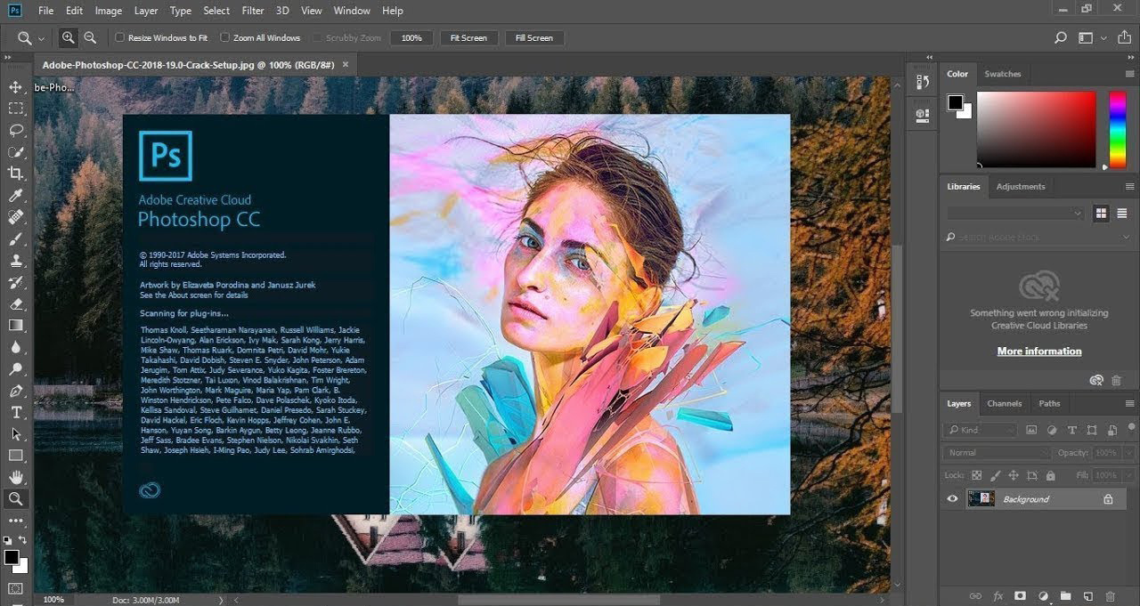
What will I study?
R094 Visual Identity and Digital Graphics
Develop Visual Identity
Plan Digital Graphics for Products
Create Visual Identity and Digital Graphics
City Life
Coming soon September 2022
Notes:
The next unit you will study is R094 Visual Identity and Digital Graphics.
If you love creating digital graphics in Photoshop you will love this unit! You will build on any skills you have learnt in Photoshop during KS3 and learn some advanced skills which will enable you to create a digital graphic for a client. When developing your visual identity and planning your graphic it is be important that you think very carefully about your client requirements and audience. The digital graphic that you create must be suitable for audience and purpose.

Slide 4
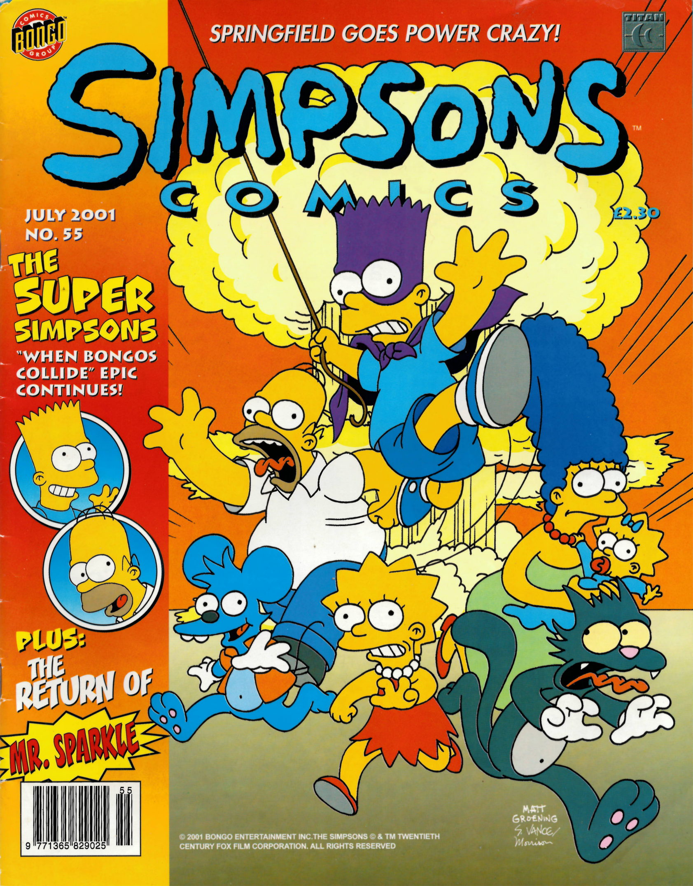
What will I study?
R095 Characters and Comics
Plan Characters and Comics
Modelling Design Ideas
Review Characters and Comics
Notes:
The final unit you will complete is R095 Characters and Comics. This unit is a really fun and interesting unit, as you will explore comics in detail starting with types of characters that convey emotion and personality all the way through to conventions of comic design and layout and storytelling across a number of pages. You will again be provided with a client brief and have to ensure your comic is suitable for your client requirements and audience.

Slide 5
How will I be assessed?
R093 Creative iMedia in the Media Industry
External Exam
1 hour 30 mins
40% of your final mark
R094 Visual Identity and Digital Graphics
Non examined assessment – NEA
25% of your final mark
R095 Characters and Comics
Non examined assessment – NEA
35% of your final mark
This Photo by Unknown Author is licensed under CC BY-SA
Notes:
We have looked at the units you will study for this qualification, this is how you will be assessed.
R093 Creative iMedia in the Media Industry is a 1 hour 30 minute external exam you will sit in the hall. The exam will make up 40% of your final grade of
R094 Visual Identity and Digital Graphics is Non examined assessment or NEA. NEA is completed in class under teacher supervision. This unit will make up 25% of your final grade.
R095 Characters and Comics is also Non examined assessment. This unit will make up 35% of your final grade.
On results day you will receive either a Level 1 Pass, Merit or Distinction or a Level 2 Pass, Merit, Distinction or Distinction *.

Slide 6
Why should I pick Creative iMedia?
Notes:
Britain’s digital creative industries, which include film, TV, music and advertising were worth more than 100 billion pounds per year in 2017.
The rate of growth since 2010 has been twice the rate of the economy overall.
Students studying such courses will be preparing for a high growth and internationally well-respected area of the economy.
https://www.gov.uk/government/news/britains-creative-industries-break-the-100-billion-barrier

Slide 7
What can Creative iMedia lead to in the future?
Go on to work in the IT and media sector:
Graphic Designer
Web Designer/ Developer
Games Designer/ Developer
TV Production Manager
Script Writer
Photographer
Project manager
Plus many other jobs
Notes:
Students who opt to take Creative iMedia can continue to study qualification in IT and/ or Media. Such courses give students the skills set to work in the It and Media sector in roles such as graphic designer, TV production manager photographer and many other jobs within the IT and media sector

Slide 8
Where can I find any further information?
Speak to your Computing Teacher during a lesson
Speak to Mrs Dunning or Mrs Fisher during a break or lunch-time
Find out more about the specification at:
https://www.ocr.org.uk/qualifications/cambridge-nationals/creative-imedia-level-1-2-award-certificate-j807-j817/
Notes:
If you are interested in studying Creative iMedia and want to find out more ask Mrs Dunning in your lesson.
Alternatively You could speak to Mrs Dunning or Mrs Fisher about the course at break or lunchtime.
Another option is to take a look at the examboard website.

