Slide 1



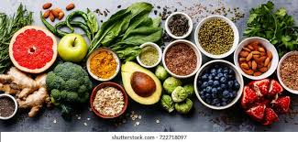
GCSE OPTIONS
Food Preparation & Nutrition
Notes:
Insert Video

Slide 2
What will I study?
From Year 9 and into Year 10 learners will study a broad range of subjects such as, ’Nutrition, Diet and Health throughout life’, ‘Food Hygiene and safety’, ‘Ingredient functionality’ as well as Food science and Food Preparation. The subject will be delivered through a range of exciting lessons including practical experimental work, group discussion, mini projects and lots of focussed skilled practical tasks. The course is approximately 50% theory and 50% practical work. By the end of Year 10 the pupils will have gained a good range of practical cookery skills to apply within their GCSE controlled assessments.
Year 11 involves the production of two controlled assessment projects which are collectively worth 50% of the overall marks of the GCSE. The projects, (None –Exam Assessment), are set with a choice of themes allowing the students to work on a project where they feel they excel. The first of these projects is a food investigation task which constitutes 15% of the GCSE marks and the second a food preparation task which has a 35% weighting. 50% of the GCSE is a written exam that involves theory knowledge that is gradually built up over the 2 years.
After GCSE Food Technology pupils can study A' level Food (external) and can go on to further education studying many different areas such as food nutrition, catering, consumer management and many more.
Notes:
Insert Video

Slide 3
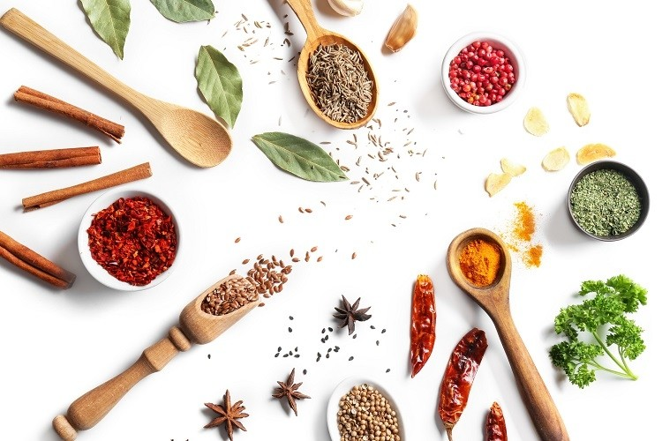
How will I be assessed?
You will be assessed throughout Years 9 and 10 by class discussion, where you will have to opportunity to share ideas and good practice, as well as peer and teacher assessment. Each unit you cover will be followed by a test on the subject areas and you will be provided with the resources to revise and improve your knowledge and understanding.
In year 11 you will start your coursework which comprises two NEA tasks. The first is a Food investigation which involves a 1500word report and the second a Food preparation task where you will cook 6 high skill dishes and produce a supporting 5000/6000 word thesis.
These tasks will be assessed against AQA criteria by your teacher and a sample will be moderated by AQA examining board.
Your written exam will be marked externally by the Exam board.
Notes:
Insert Video

Slide 4
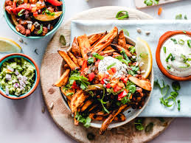
Why should I chose Food & Nutrition?
There are many reasons why people choose Food as a subject to study. There is the obvious where we have a passion for cookery and a love of the subject as well as to explore and move into the many career pathways that this subject allows.
Whether an aspiring Chef or devoted Foodie, the course has a lot to offer.
.
Notes:
Insert Video

Slide 5

What can Food & Nutrition lead to in the future?
After GCSE Food Technology pupils can study A' level Food (external) and can go on to further education studying many different areas such as food nutrition, catering, consumer management and many more.
Notes:
Insert Video

Slide 6
Where can I find any further information?
www.aqa.org.uk/subjects/food-preparation-and-nutrition-/gcse/food-preparation-and-nutrition-8585
Notes:
Insert Video

