Slide 1



GCSE OPTIONS
SPANISH
Notes:
Insert Video

Slide 2

What will I study?
AQA Spanish GCSE Course (8698)
You will study 3 broad themes, focusing on one theme per year.
Each theme is divided into 4 topics.
For each topic, you will learn the relevant vocabulary, structures and grammar, whilst developing the four key skills: listening, speaking, reading and writing.
Culture is inherent to the course and explored throughout the themes.
Notes:
Insert Video

Slide 3
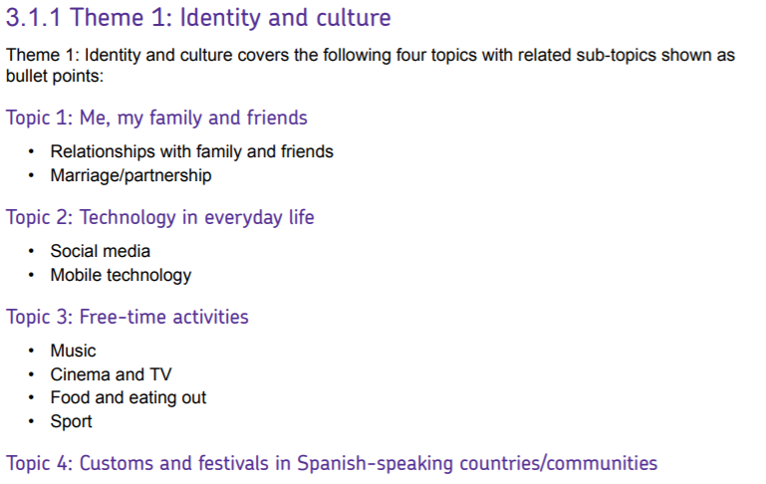
What will I study?
Year 9
Notes:
Insert Video

Slide 4
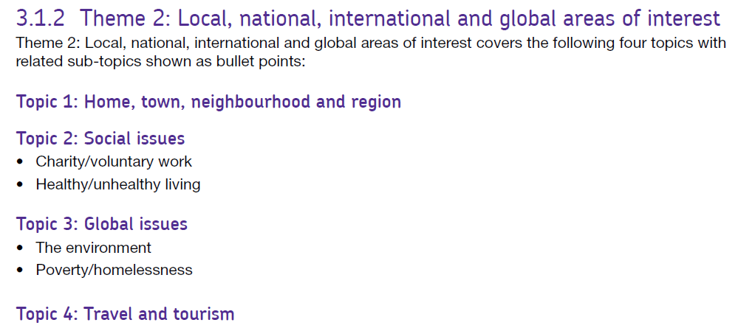
What will I study?
Year 10
Notes:
Insert Video

Slide 5
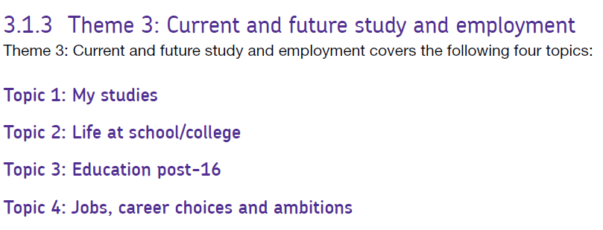
What will I study?
Year 11
Notes:
Insert Video

Slide 6
How will I be assessed?
Foundation Tier
Grades 1-5
Higher Tier
Grades 5-9
Paper 1: Listening
35 min, 25%
Paper 2: Speaking
Role-play
Photo card
Conversation
7-9 minutes, 25 %
Paper 3: Reading
45 min, 25%
Paper 4: Writing
1 hour, 25%
Paper 1: Listening
45 min, 25%
Paper 2: Speaking
Role-play
Photo card
Conversation
10-12 minutes, 25%
Paper 3: Reading
1 hour, 25%
Paper 4: Writing
1h15 min, 25%
Notes:
Insert Video

Slide 7





Why should I pick Spanish?
Notes:
Insert Video

Slide 8





What can Spanish lead to in the future?
Jobs and sectors directly related:
language teacher/tutor
translator
interpreter
news reporter
tourism (e.g. tour guide)
flight attendant
diplomatic services (e.g. UN, EU)
hospitality services (e.g. hotels)
fashion industry
intelligence services
(e.g. Weapon Systems Operator Linguist)
Jobs supported by the skills:
- journalist, broadcaster
public relations
marketing
business
charity work
engineering
sales
customer service
IT
entertainment industry
medicine sector
army forces
Notes:
Insert Video

Slide 9
Where can I find any further information?
Speak to your language teacher(s) directly at the end of a lesson or message them directly through Satchel One.
You can also get in touch via email:
Mr Cowley daniel.cowley@oldburywells.com
Miss Dijoux solene.dijoux@oldburywells.com
Mrs Whyton-Owen debbie.whytonowen@oldburywells.com
http://www.whystudylanguages.ac.uk/ks3/why_languages/
https://www.all-languages.org.uk/research-practice/why-study-languages/
If you already know what job you would like to do, check the qualification and the entry requirements as languages may be one!
Notes:
Insert Video

