Slide 1
AQA
GCSE
Design and Technology 8552
Modern materials
Unit 2
Energy, materials, systems and devices
3

Slide 2
Objectives
Be able to recognise a range of modern materials
Describe developments made through the invention of new or improved processes involving modern materials
Explain how modern materials can be used to alter functionality

Slide 3
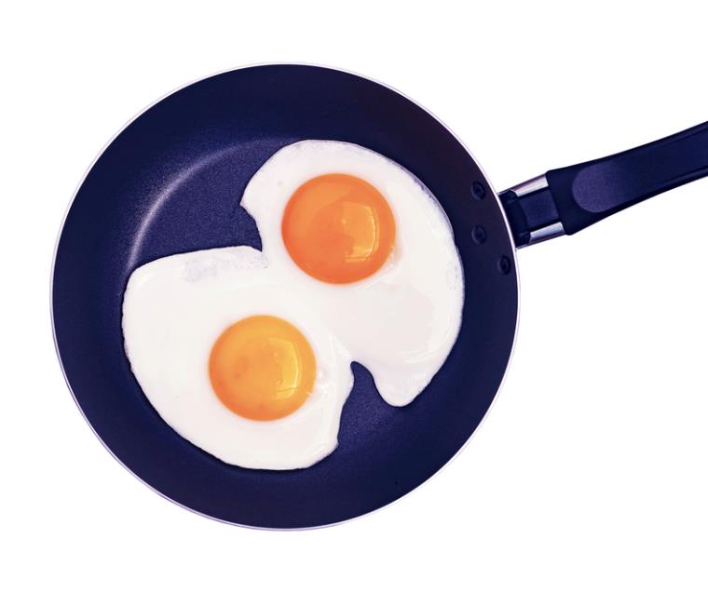
Modern materials
New and improved materials are constantly being discovered and developed
Modern materials can help to solve:
design issues
technical constraints
environmental issues
Which non-stick modern material is used to coat some kitchen equipment?

Slide 4
What is a modern material?
Modern materials are new inventions or one that has been relatively recently discovered
A material or element may also be used or combined in a way that is different from its normal function
It might be blended, coated, alloyed or treated to improve its functional or aesthetic properties
Which modern security features do many new bank notes have?

Slide 5
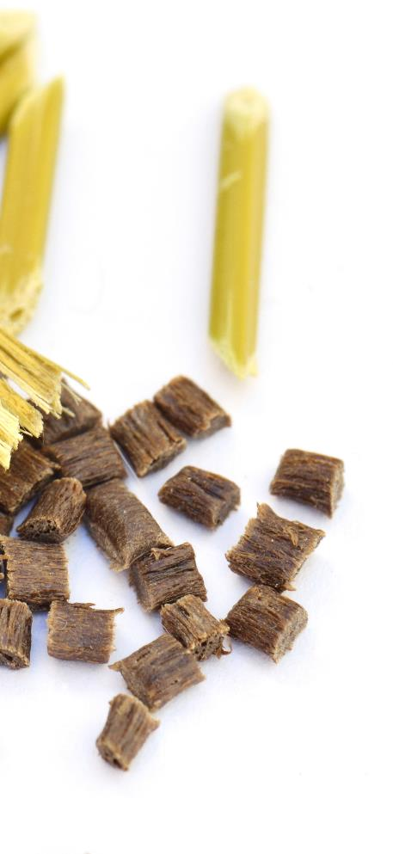
Biodegradable polymers
Biodegradable polymers are made from vegetable starches, often corn-starch
Common varieties include:
Polylactic acid (PLA) commonly used in 3D printing filament
Polyhydroxybutyrate (PHB) under the trade name BiopolTM
Polycaprolactone (PCL) known as Polymorph
Why might some biodegradable polymers struggle to decompose in a landfill site?

Slide 6
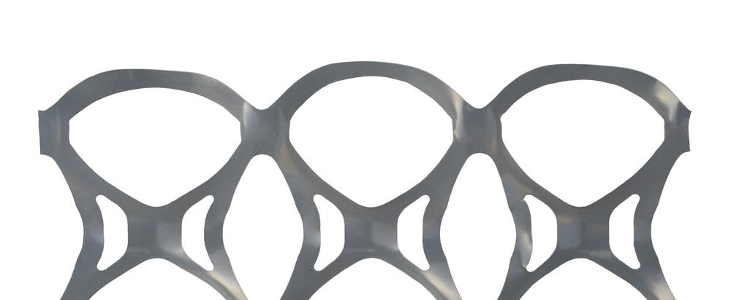
Did you know…?
The Saltwater Brewery (Florida USA) used wheat and barley remnants from brewing their beer to make 100% biodegradable, compostable and edible six-pack rings
Discuss which other commonly thrown away plastic products could benefit from being made from such a modern material

Slide 7
Polymorph and CoolmorphTM
Polycaprolactone (PCL) is a low temperature, hand-mouldable polymer
Polymorph fuses at 62°C, although CoolmorphTM bonds together at just 42°C making it easier to use
They are both biodegradable, non-toxic and can be coloured
They are ideal for modelling as they can be shaped using only hand pressure
They can be reused and remoulded multiple times
How could PCL be used to make repairs to household items?

Slide 8
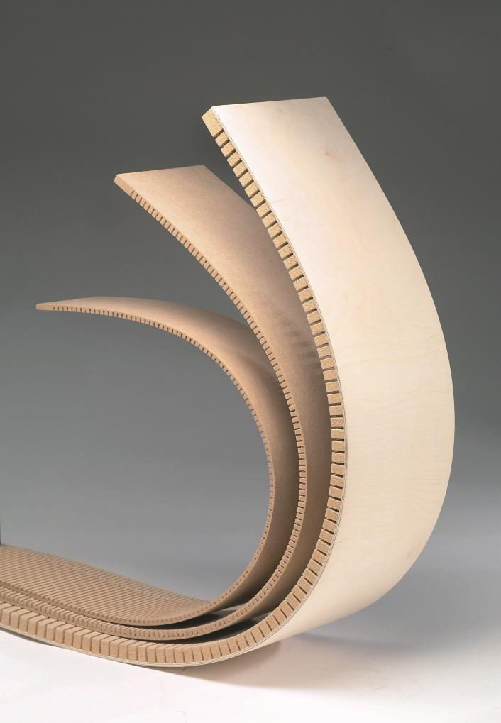
Flexible MDF
Flexible MDF allows for the creation of natural curves
It is commonly used in the design of shop fittings and bespoke commercial projects
Routed or machined grooves enable the material to bend
Name an alternative flexible timber-based material?

Slide 9
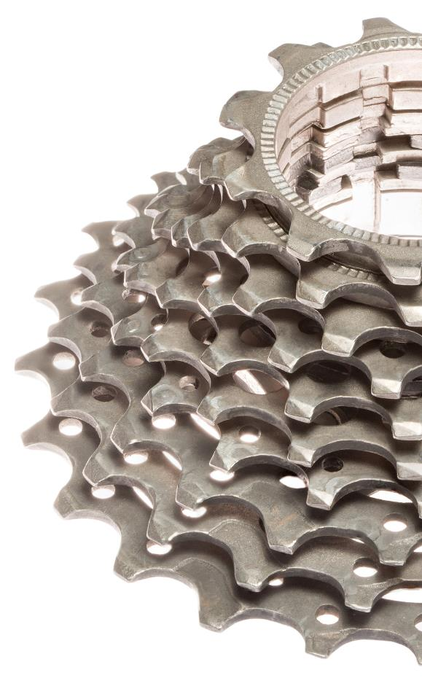
Titanium
Although a chemical element, titanium is commonly alloyed with other metals
It is relatively lightweight, tough and stiff with low density
It has excellent corrosion resistance making it very versatile
Titanium does not react with the human body, making it ideal for medical applications
Where might a metal with these properties be useful?

Slide 10
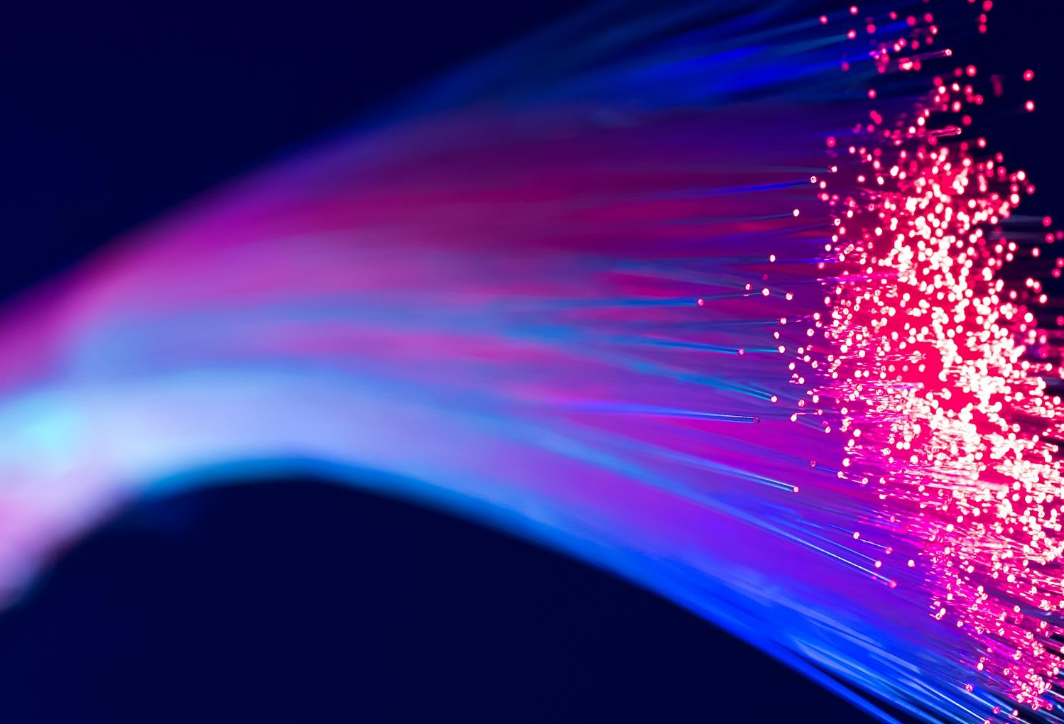
Fibre optics
Fibre optic cables carry light down a thin glass core
Uses include:
Cable TV and broadband infrastructure
Medical applications using endoscopes to allow doctors to see into the body
Fun optoelectronics and novelty goods
How could this technology be beneficial to the Police and the Military?

Slide 11
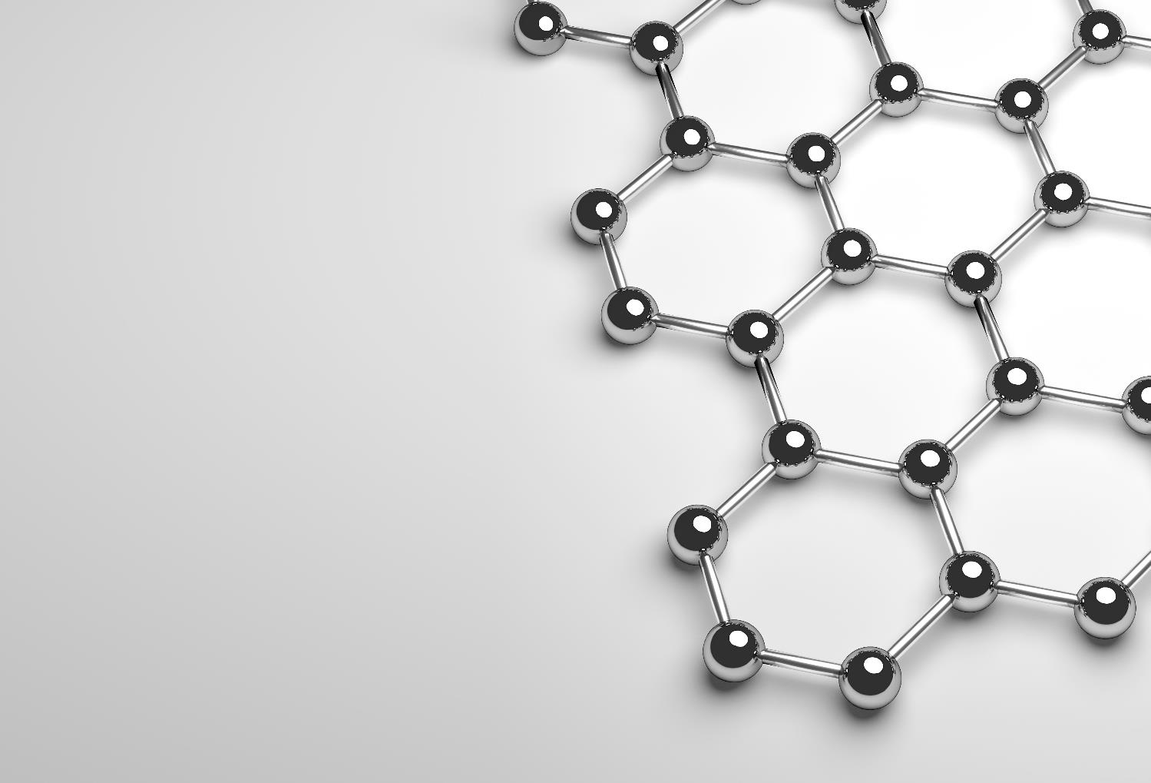
How thin?
Imagine a material one atom thick that is:
200x tougher than steel
stretchable and flexible
transparent yet impermeable
highly electrically conductive
What could this be?
How might it be used?

Slide 12
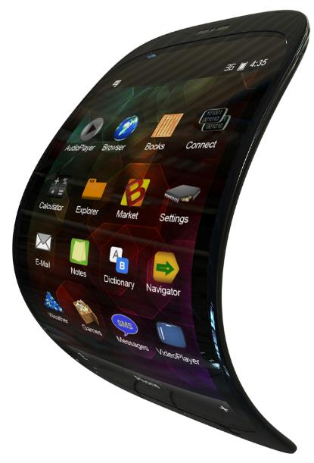
Graphene
Graphene was accidentally discovered in 2004
Research into the uses of graphene is currently active in many areas including: flexible electronics, biomedicine, energy storage and composite materials
Scientists are very optimistic about its future applications
How could flexible electronics benefit the consumer?
How could lighter and tougher materials assist the elderly or disabled?

Slide 13
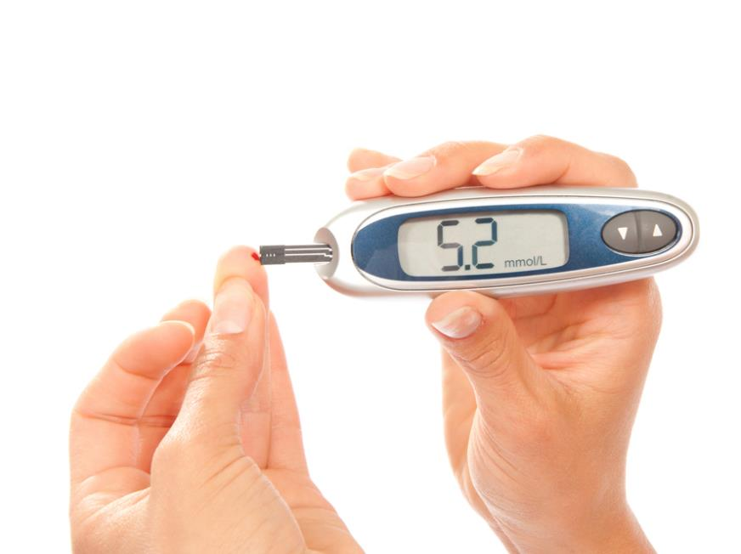
Liquid Crystal Display (LCD)
LCDs come in monochrome and full colour versions
Screens can be very small and lightweight
Bespoke monochrome layouts can be achieved
They have very low power consumption
LCDs do not emit light, so they require back lighting
Colour versions use pixels
Where might you find LCDs in use?

Slide 14
Nanomaterials
Exactly how small are nanomaterials?
From the chart below, you can see a grain of sand is roughly one million times larger than a nanometre
Nanomaterials range from 1 to 1000 nanometres
Nanomaterials benefit from their scale and increased surface area, but what do they actually do?
Nanomaterial range

Slide 15
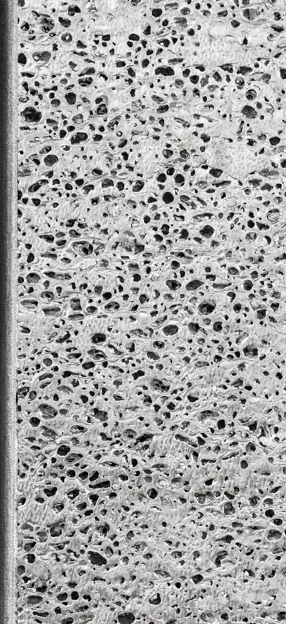
Metal foam
Metal foams are very lightweight compared to solid metals
As little as 25% of the mass of the solid metal is used
The air pockets are made by injecting gas into liquid aluminium or titanium
They are 100% recyclable
How might metal foams be beneficial to the aircraft and automotive industries?

Slide 16
Worksheet 3
Complete the worksheet

Slide 17
Plenary
Name two modern materials that can be shaped using heat
Which modern materials are currently in a very early stage of development?
Explain how biodegradable polymers reduce the amount of fossil fuel used in plastic manufacturing
Which modern materials can be used to improve strength-to-weight ratios and performance in the automotive industry?

