Slide 1
AQA
GCSE
Design and Technology 8552
Ecological and social footprint
Unit 4
Common specialist technical principles
3

Slide 2
Objectives
Understand that greenhouse gases and carbon are produced during the manufacture of products
Understand the impact that a consumer society has on natural resources and the environment including deforestation, mining, drilling, farming and product miles
Be aware of the need for social and governmental responsibility to address safe working conditions and pollution

Slide 3
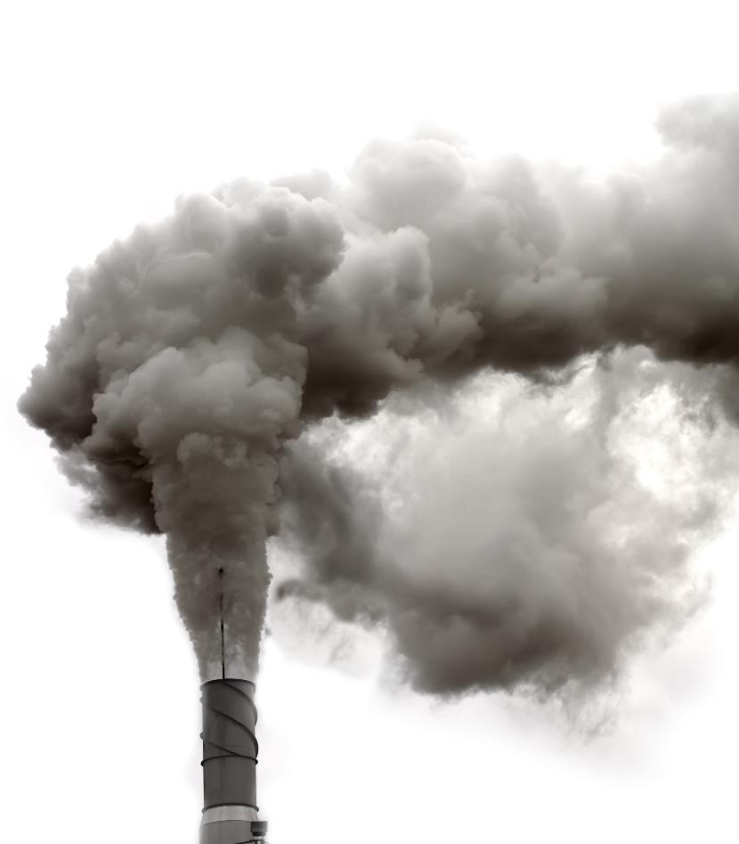
Global emissions
There are many sources of environmental pollution that are warming the earth
What are the two key greenhouse gasses?
What kinds of human activity generate greenhouse gases and carbon?

Slide 4
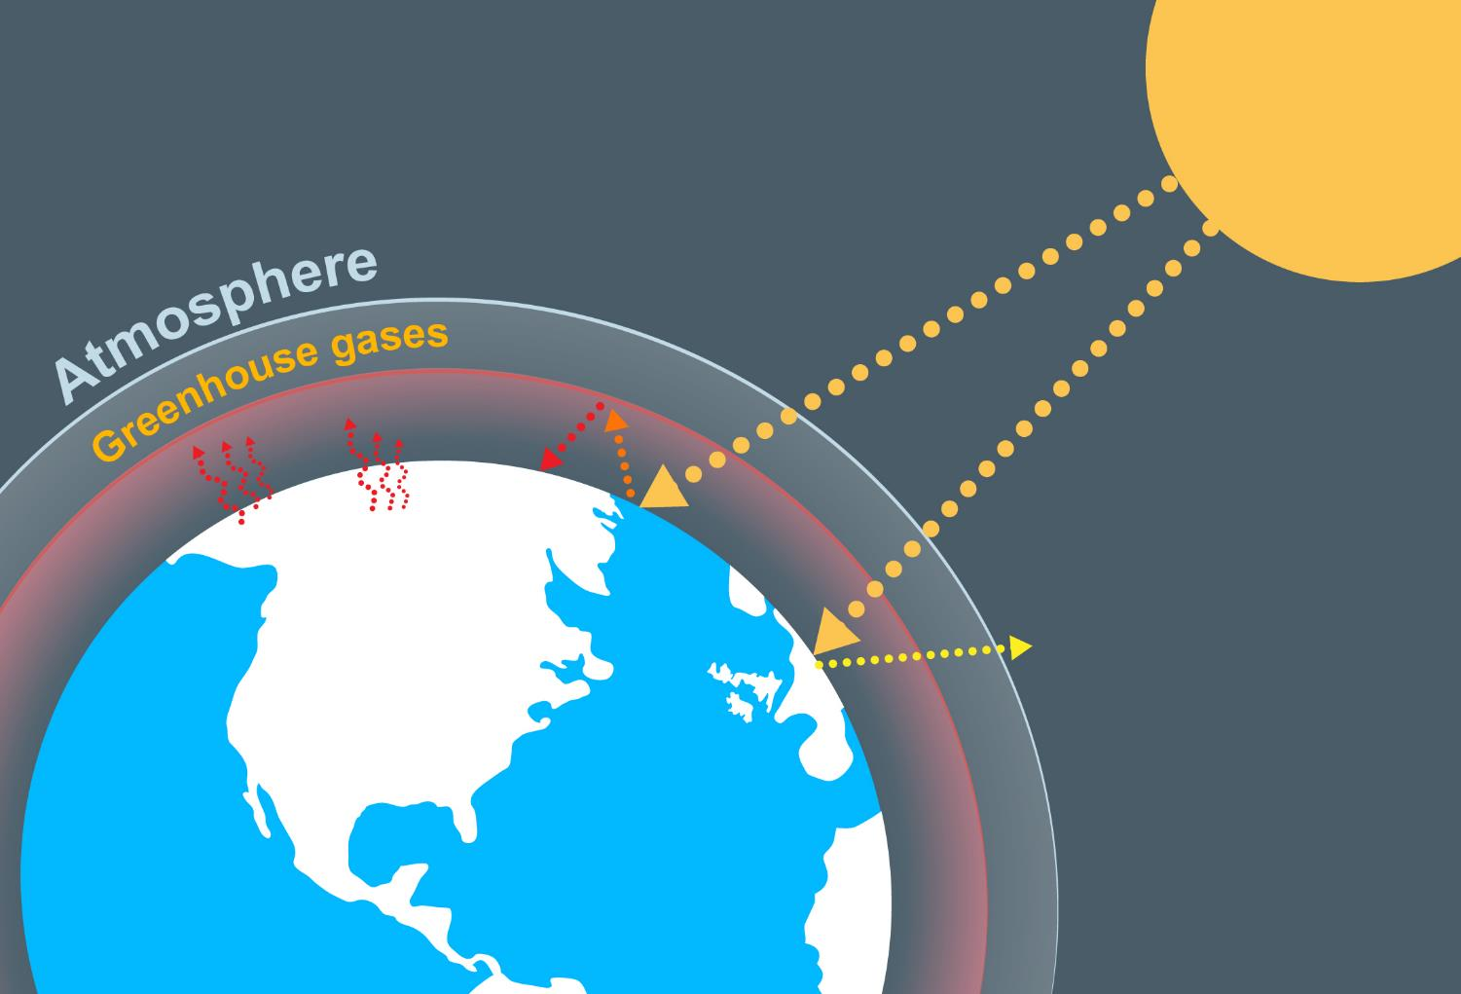
The greenhouse effect
What is the “greenhouse effect”?

Slide 5
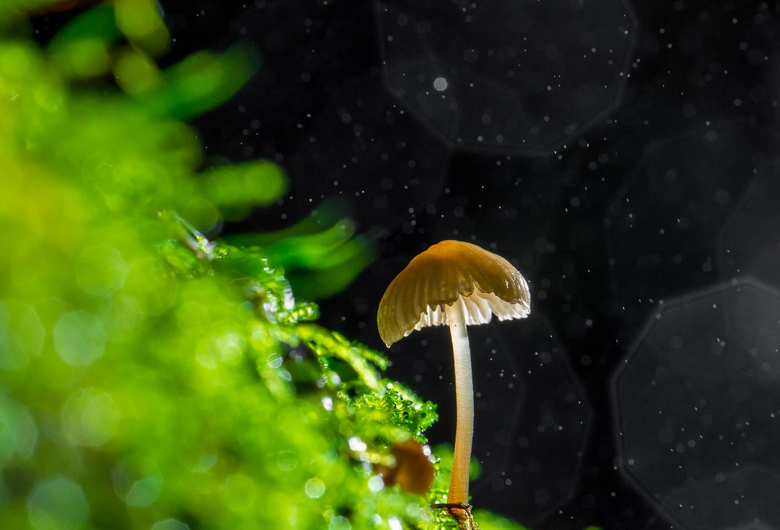
How does nature help?
How do plants affect the carbon content in our atmosphere?
How could human activity help to reduce the greenhouse effect?

Slide 6
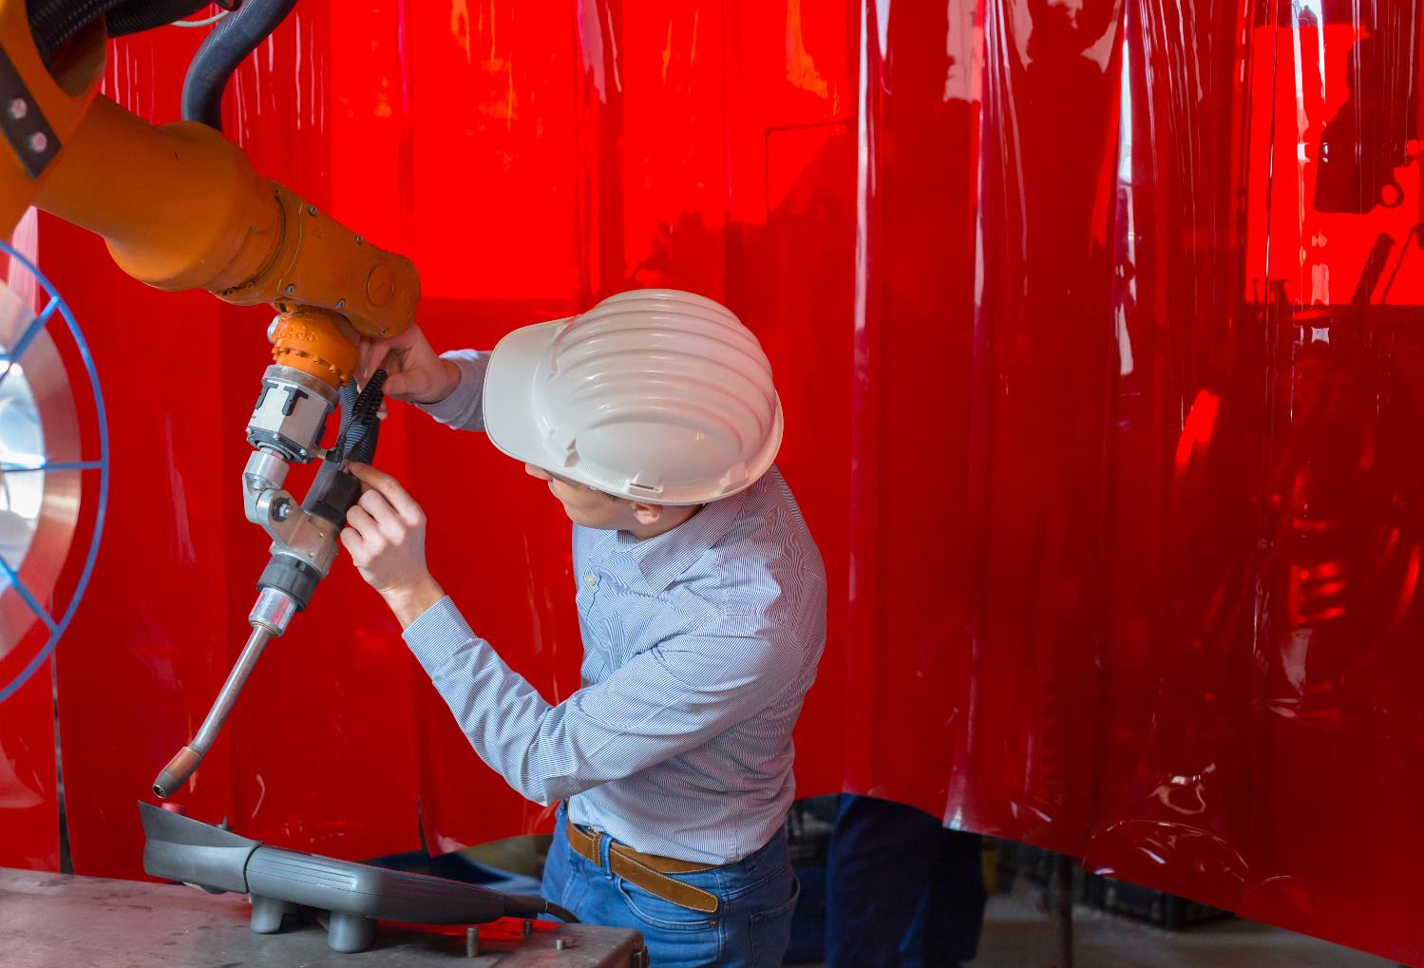
Product manufacture
How does the manufacture of everyday products affect carbon emissions?

Slide 7
Carbon footprint
A carbon footprint is the amount of carbon dioxide released into the atmosphere as a result of the actions of an individual, organisation or community
How might your lifestyle choices affect your carbon footprint?

Slide 8
Consumer society
What do you understand by the term consumer society?
A society in which the buying and selling of goods is the most important social and economic activity
How might living in a consumer society affect your carbon footprint?

Slide 9
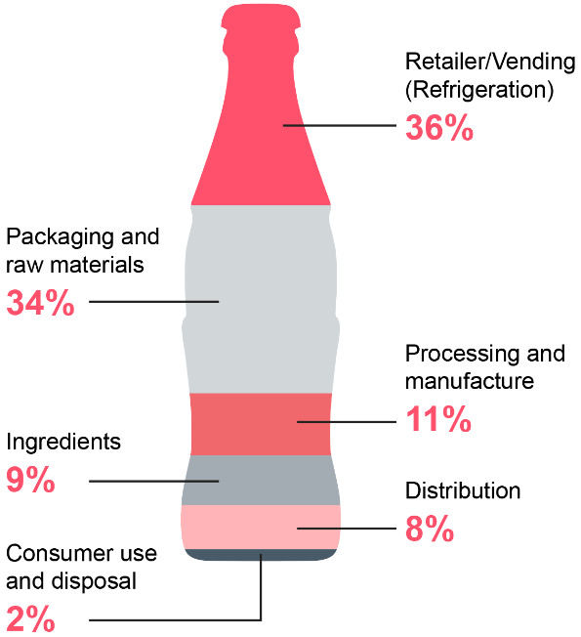
Carbon footprint of products
Looking at the carbon footprint of a product is a way of measuring its environmental impact
How can designers reduce the carbon footprint of the products they bring to market?
How can your buying choices reduce your carbon footprint?
Carbonated beverage in a 600ml Polyethylene (PET) Bottle

Slide 10
Worksheet 3
Complete Tasks 1 and 2
How is global warming caused?
How can lifestyle choices add to or reduce an individual’s carbon footprint?

Slide 11
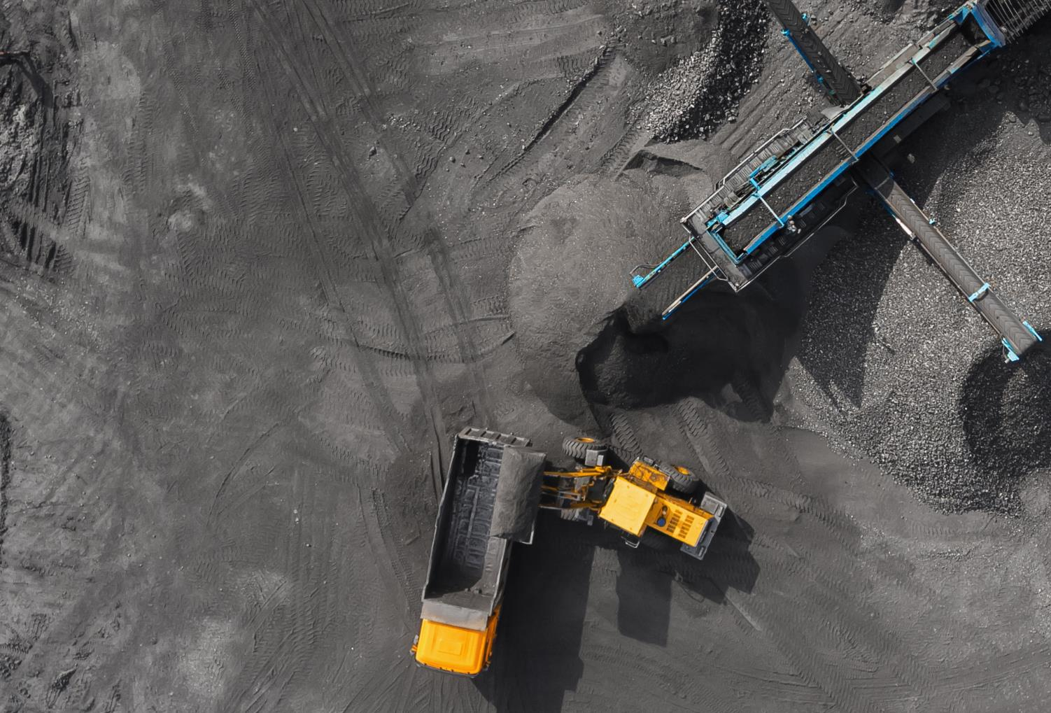
Mining
What kinds of materials come from mines?
How are explosives used in mining?
What is the difference between surface mining and underground mining?
What are the negative impacts of mining?

Slide 12
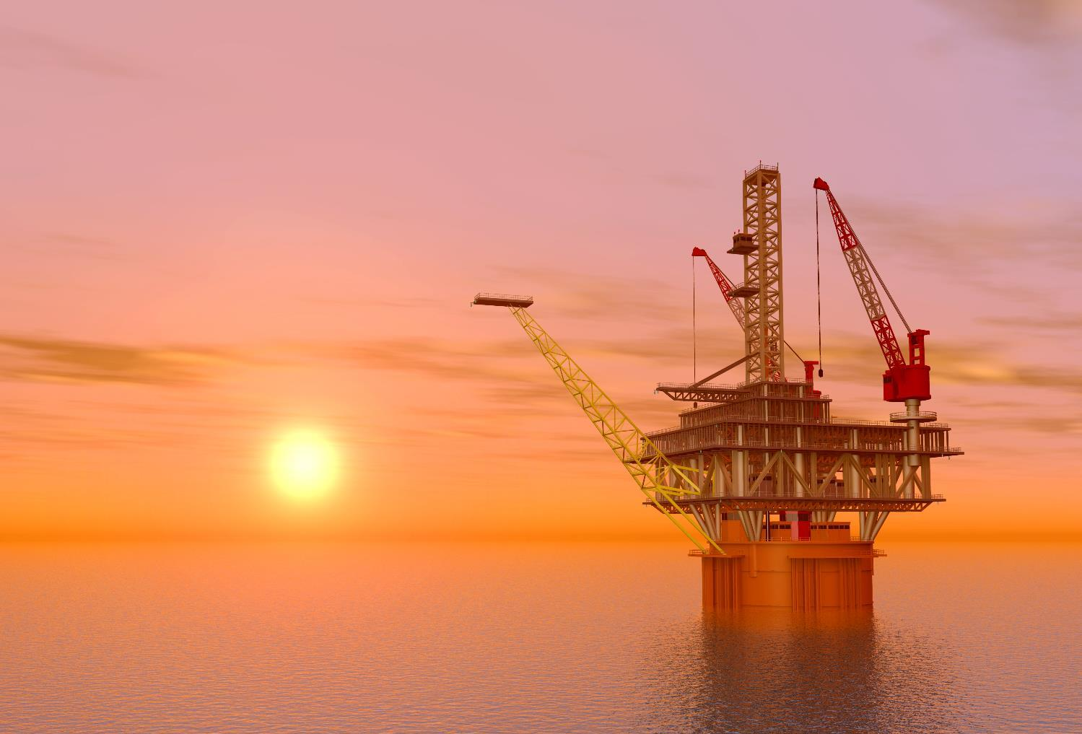
Drilling
Which fossil fuels are harvested through drilling?
Rigs are often set up off-shore
Why do some rigs need to be built in the sea?

Slide 13
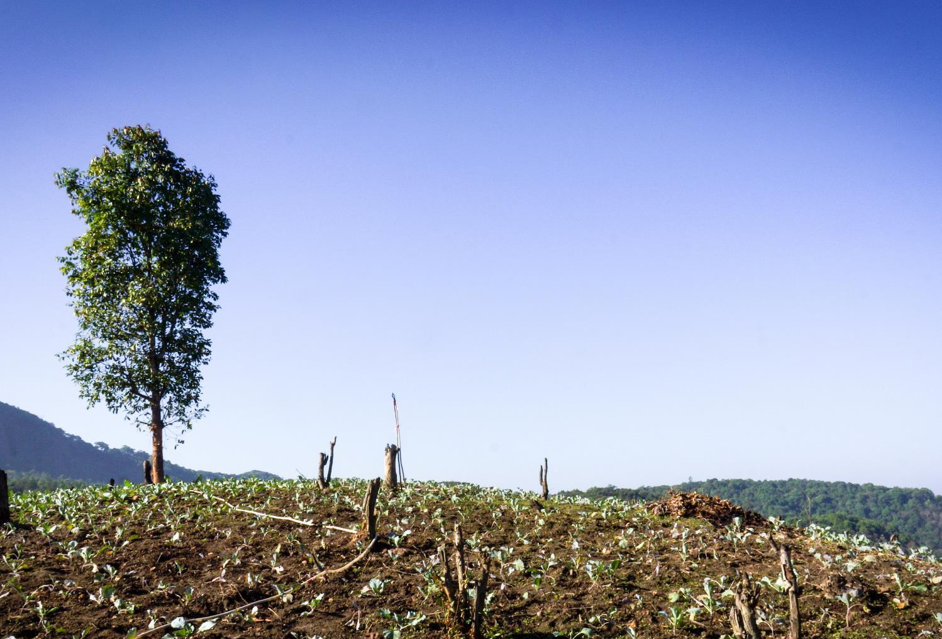
Deforestation
Large areas of forest and rain forest are destroyed to harvest wood and/or make way for farmland
How does this affect biodiversity?
“Slash and burn” is a technique used to clear large forested areas – What do you think this means?
How can we source timber more responsibly?

Slide 14
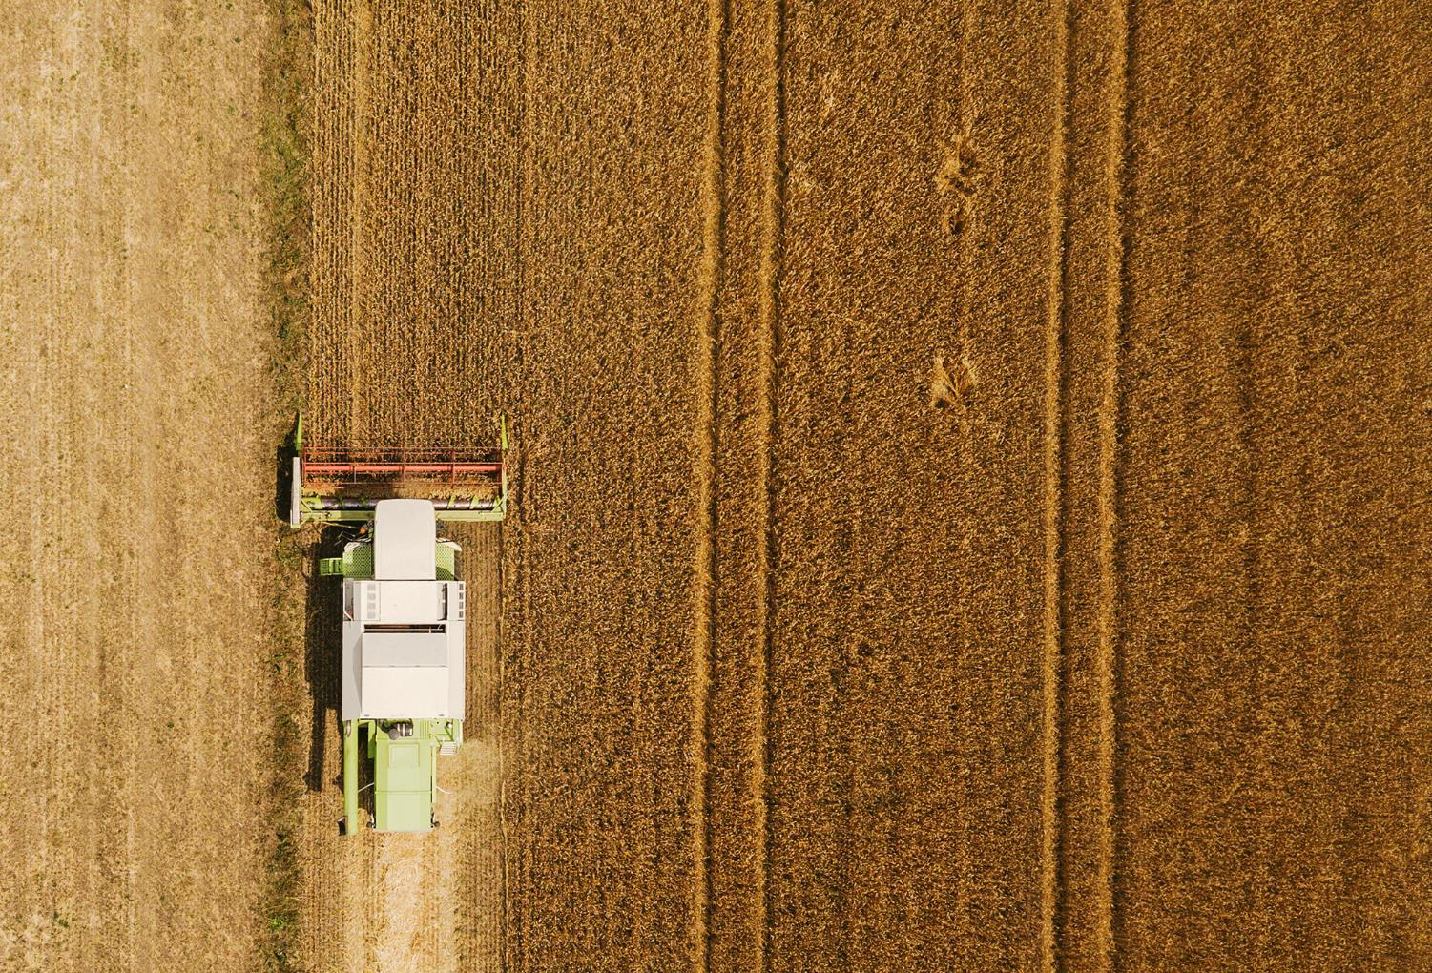
Farming
It is estimated that 15% of greenhouse gas emissions are generated from farming
What kinds of chemicals are used to increase yield?
As populations grow and the demand for meat increases, so too do the negative effects of farming
Farming is used to grow crops for biofuels such as oilseed rape

Slide 15
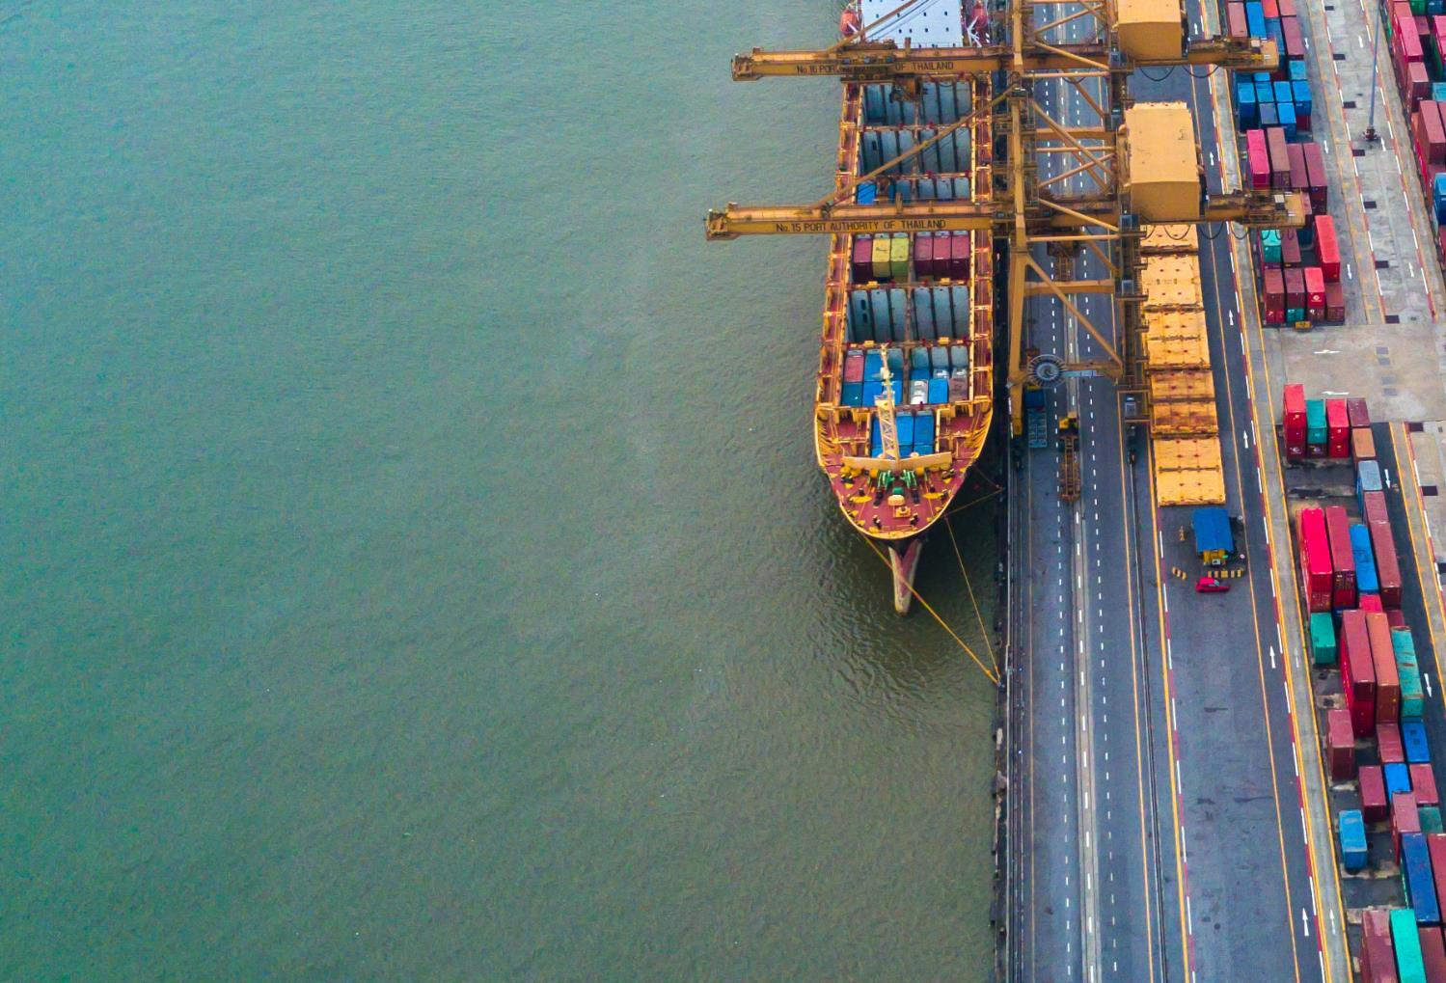
Product miles
Product mileage refers to the distance travelled by a product, from raw material source, to manufacturer, to user and on to final disposal
Why does ‘buying local’ reduce environmental impact?
How might buying products locally have a positive social impact?

Slide 16
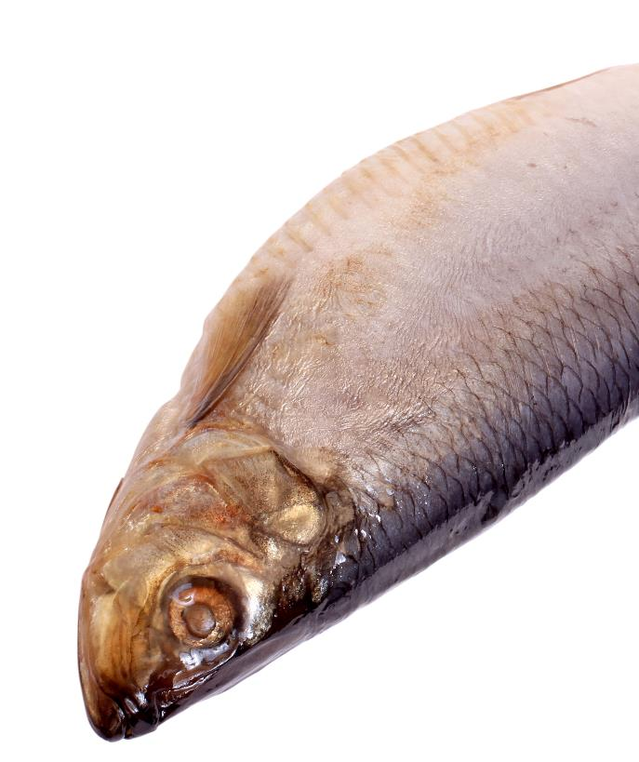
Oceanic pollution
The pollution of waterways and oceans is caused by the mismanagement of toxic by-products
Oceanic pollutions might be toxins such as fertilisers, dyes and chemicals being released or washed into the water system
Why are polymer based products particularly damaging to our oceans compared to wood or metal?

Slide 17
Atmospheric pollution
Emissions from all kinds of human activity can have a detrimental affect on the quality of our air
What might be the sources of some of these emissions?
What are the effects of atmospheric pollution on the planet?
How might it affect personal health?

Slide 18
Worksheet 3
Complete Tasks 3 and 4 of the worksheet

Slide 19
Social responsibility
We all have a responsibility to make more sustainable decisions in our lifestyles that will help reduce our environmental impact
As designers, why might our decisions have more impact than most?

Slide 20
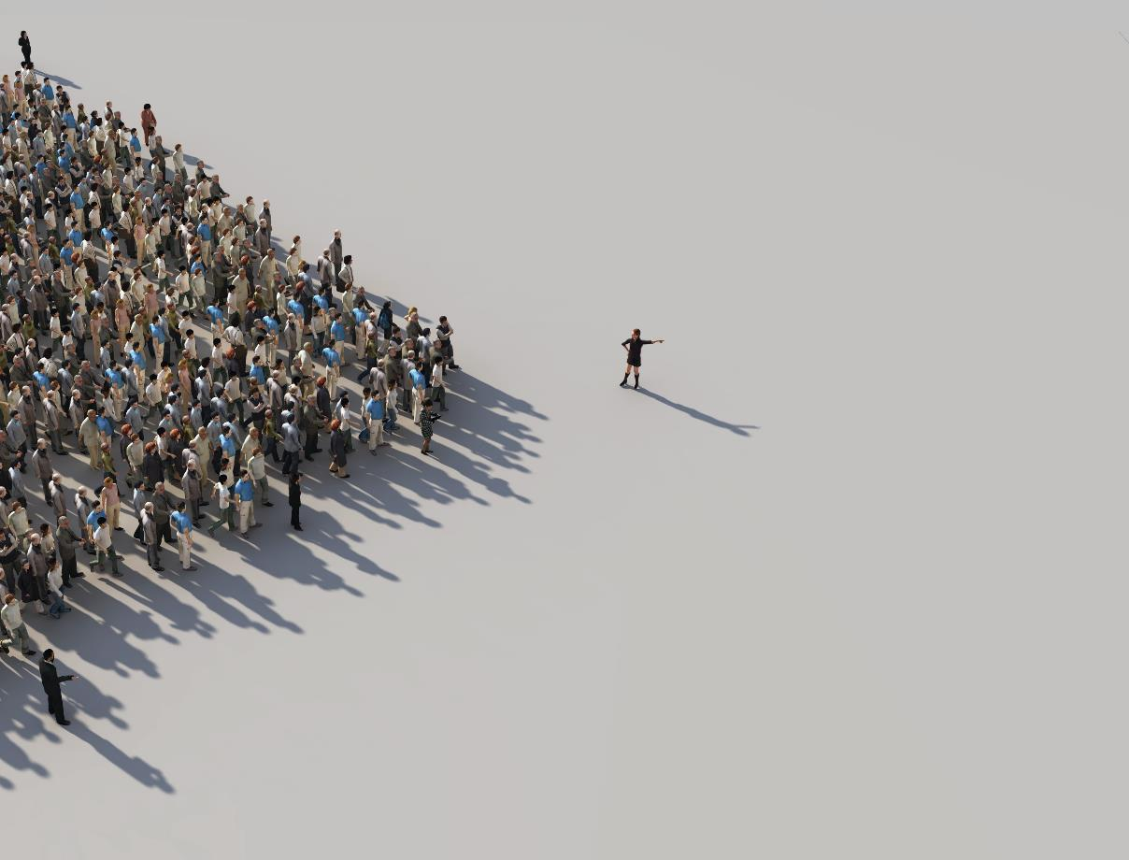
Social footprint
This measures how far a company’s policies affect all stakeholders in the company, as well as wider society
Who are the stakeholders in a company?
What kind of social issues might company policies affect?

Slide 21
Government responsibility
Governments have a responsibility to protect our environment and ensure safe working conditions
What kinds of commitments would you make to reduce environmental impact if you were in charge?

Slide 22
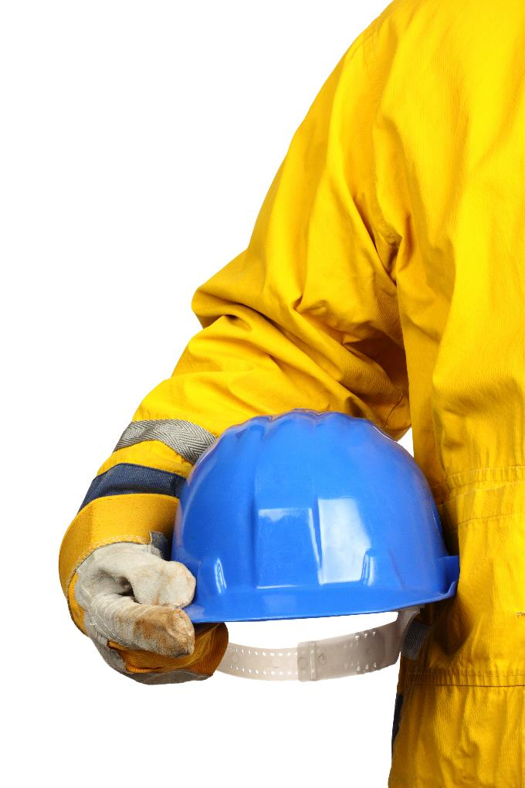
Safe working conditions
Governments set rules that outline safe working conditions for employees as well as the minimum wage
In the UK, the Health and Safety Executive (HSE) ensures employers have a legal obligation to provide a safe working environment
Some countries are more relaxed about health and safety law than others
How might employees’ health and safety be compromised?

Slide 23
Worksheet 3
Complete Task 5
Consider the risks associated with different jobs
What could a company do to help mitigate against these risks?

Slide 24
Recent legislation
The Kyoto Protocol is an international commitment to reduce greenhouse gas emissions signed by 192 out of 196 countries on the planet
The Paris Agreement, adopted by 195 countries in 2016 was the world’s first comprehensive climate change agreement to:
Limit the increase in global average temperature to well below 2°C above pre-industrial levels
Reduce greenhouse gas emissions
Give financial support for low-emission development

Slide 25
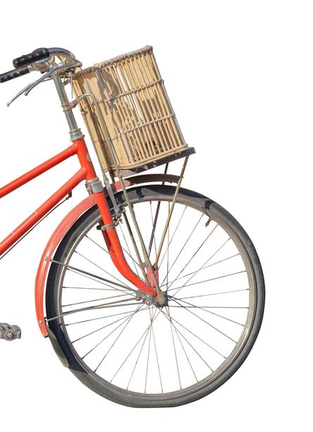
Plenary
Consider the following:
Are bicycles a carbon neutral product?
Why might biofuels be considered carbon neutral?
How could the carbon footprint of a school be reduced? What about our social footprint?
Why might organic foods be better for the environment?
How could packaging be redesigned to reduce environmental impact?
How might low pay increase risk factors for workers?

