Slide 1
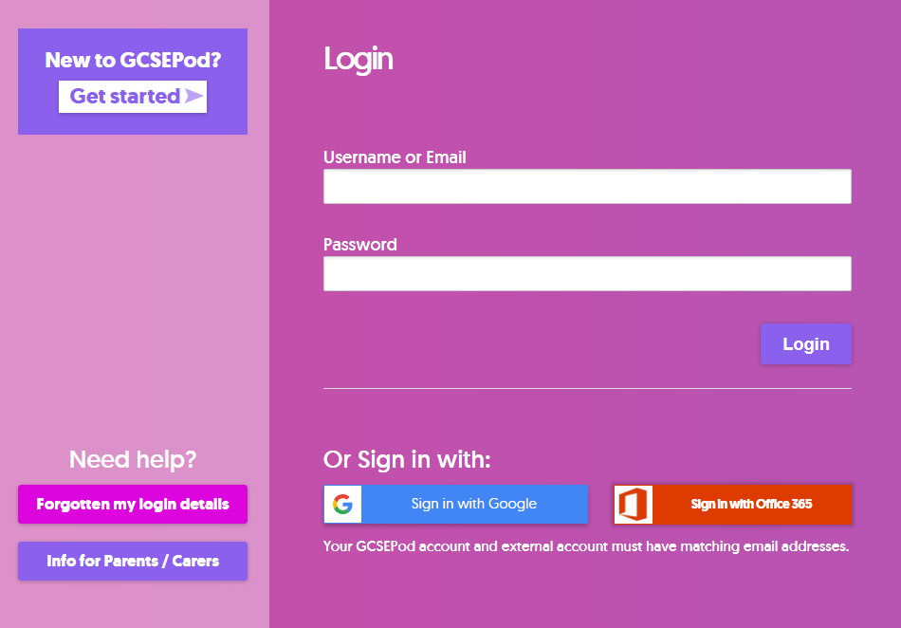
How do I log-in to GCSE Pod?
Visit: https://www.gcsepod.com/ and click sign in
To sign in – simply select the Office 365 option
When prompted add your school email address.
You may be prompted for your school email and password that you use to logon to the school system.

