Slide 1
GCSE OPTIONS
Art and Design
Notes:
Insert Video

Slide 2
What will I study in Year 9?
GCSE starts with two introductory projects and skill development in Yr. 9.
1. FINE ART UNIT: You will create a Fine Art panel as artwork for display in one of the following spaces: Local School, Vets, Doctors Surgery, Hospital, Art Gallery, Company Headquarters or local restaurant.
You will develop research into your own personal theme looking at images and artists.
You will test out the images by drawing using different processes and techniques taught through practical work.
2. GRAPHICS UNIT: You will design and make a magazine cover for one of the following contemporary themes of Fashion, Music or Animals by:
• Experimenting with different drawing techniques and media to build up observation skills.
• Using creative text to develop effective ideas for magazine titles that are professional and well-presented.
• Presenting research on an illustrator of painter and work in creative ways.
• Working in Adobe Photoshop and by hand to develop graphical ideas.
Notes:
Insert Video

Slide 3
What will I study in year 10 & 11?
Year 10/11 Coursework Portfolio 60%: - You will produce two portfolios over the two years to include:
Experimenting with a range of personal themes base on Monochrome and Artist inspired briefs.
The study of artists, illustrators and graphic designers to inspire project work.
Development of ideas, which reflect personal strengths either using, mixed media, 3D presentations, painting or graphics.
Graphics produced by hand or Photoshop designs.
Year 11 Practical Exam 40%: - Jan - May.
You will produce an imaginative personal response, with teacher support, to a series of starting points with the development of a final piece produced in 10 hours under exam conditions. The preparation work is structured in a similar way to the coursework portfolio with an inspirational PowerPoint at the beginning to get the creative juices flowing! You will work to your own strengths of media, processes and ideas. The exam allows you to develop your own personal project linked to an exam title set by the exam board.
Notes:
Insert Video

Slide 4
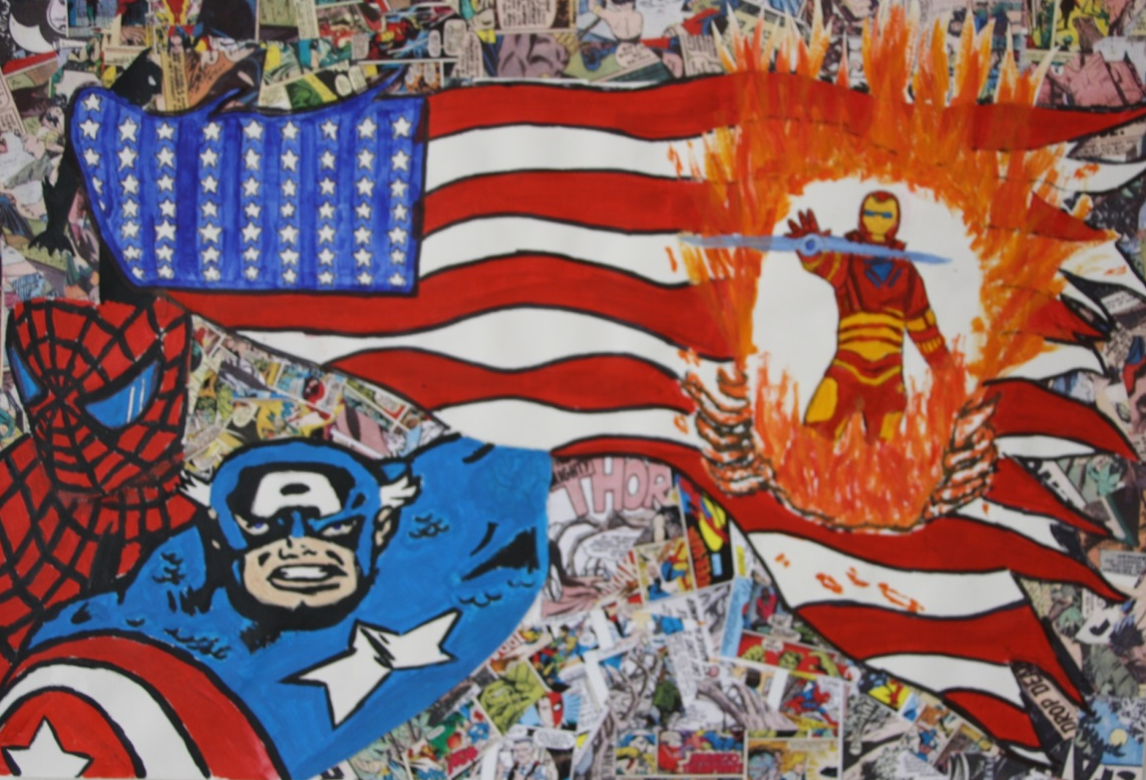
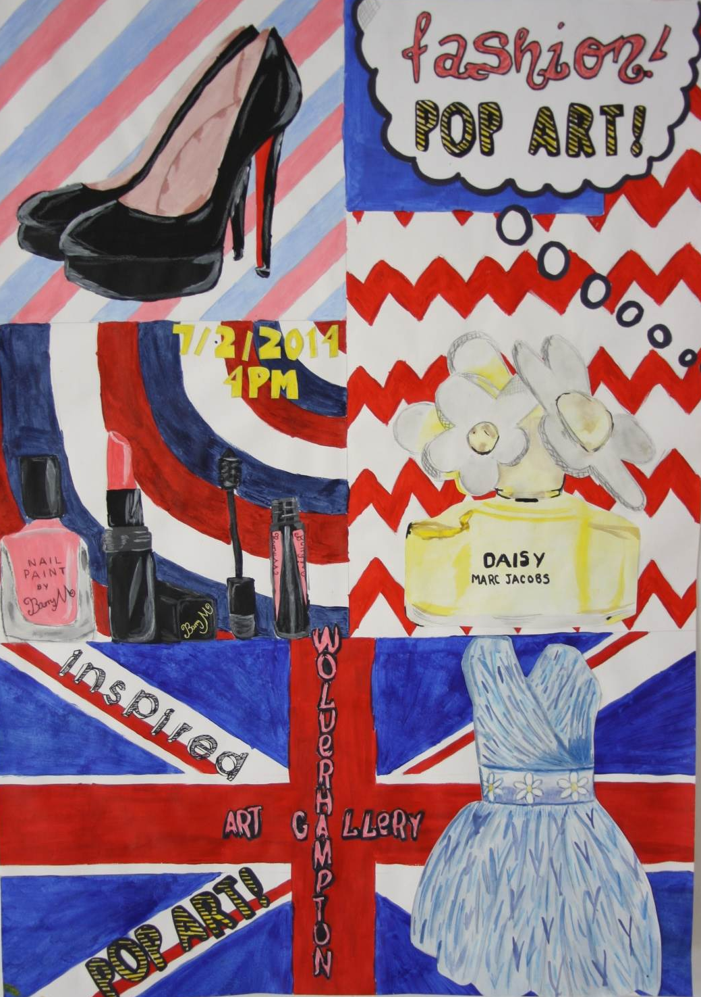

Slide 5
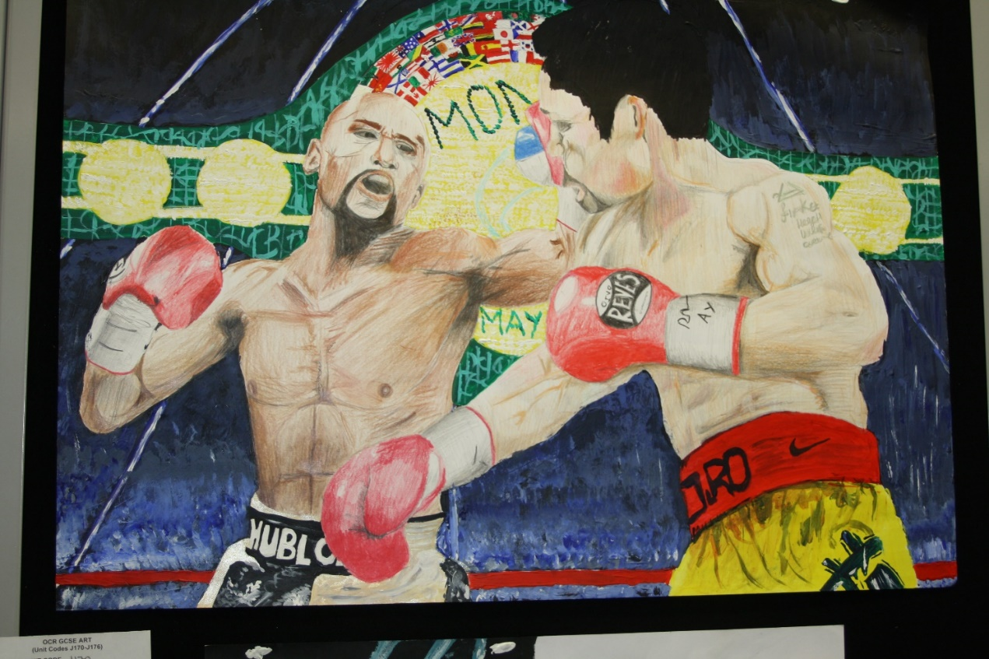

Slide 6
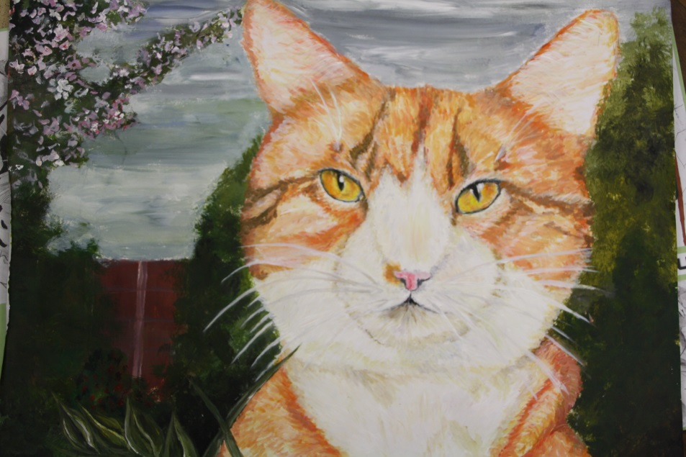
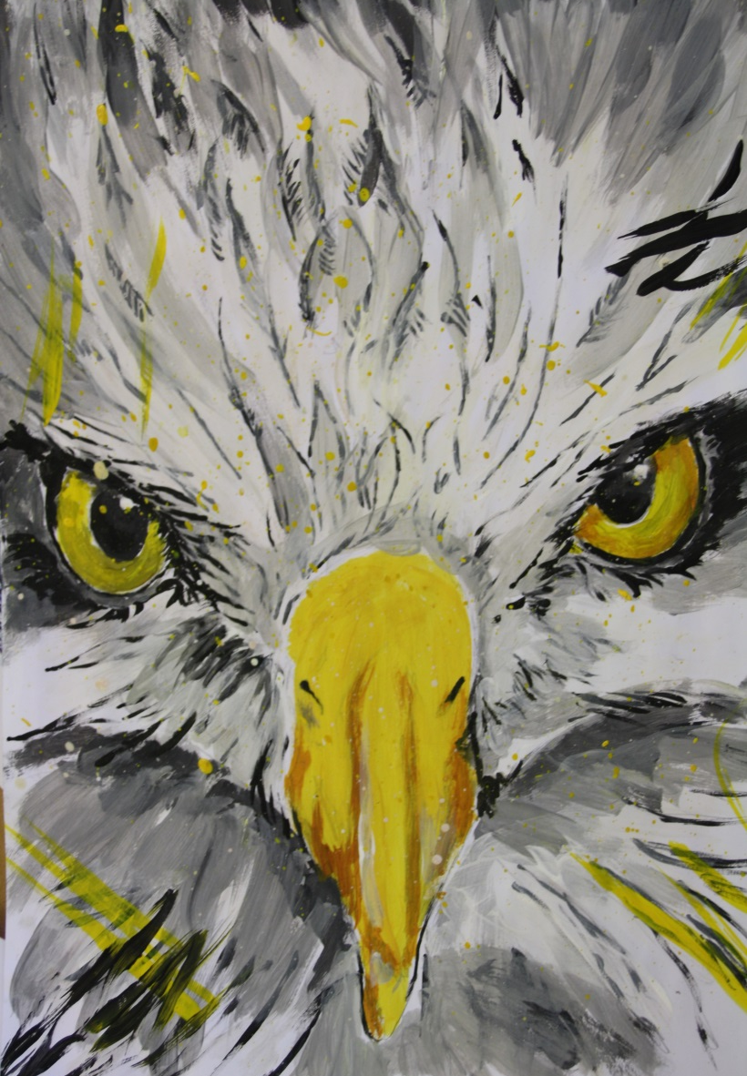
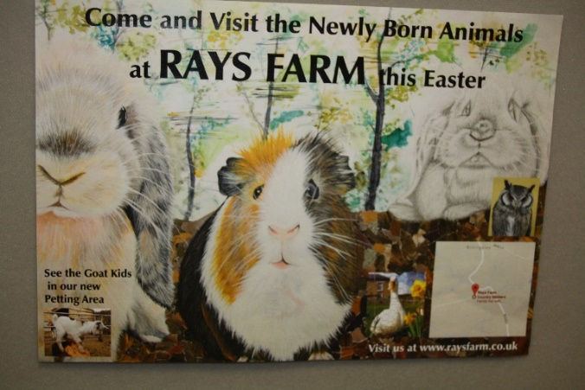

Slide 7
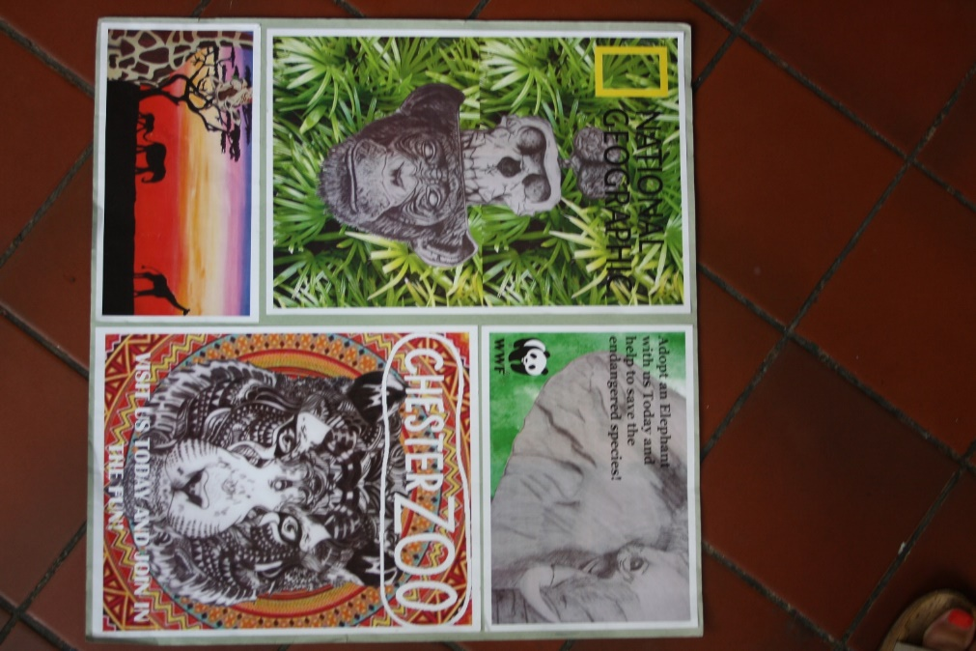
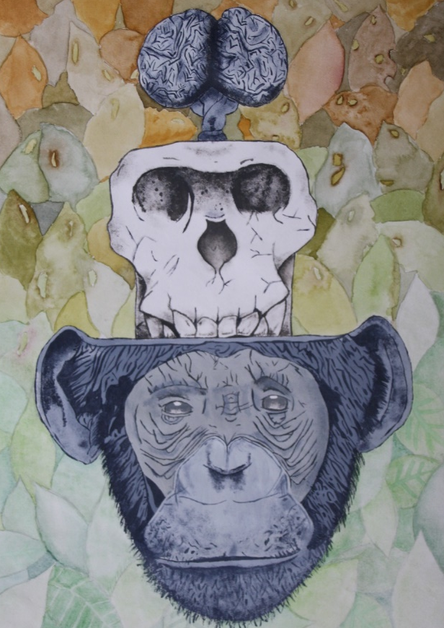

Slide 8
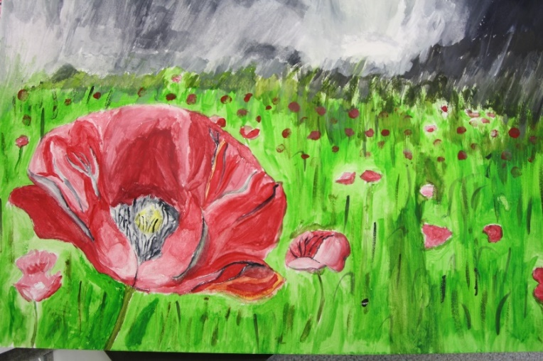
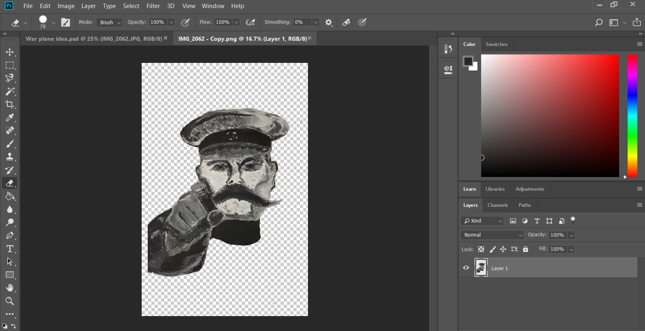
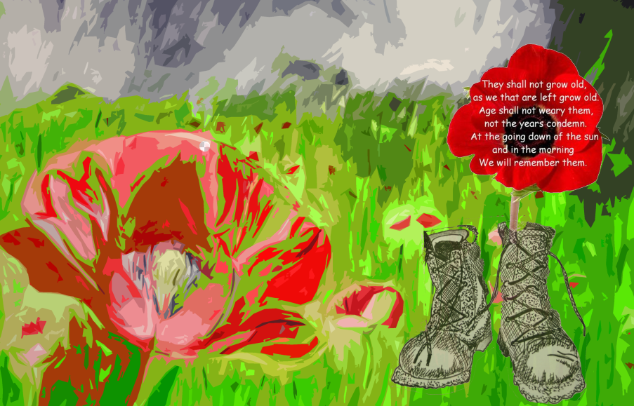
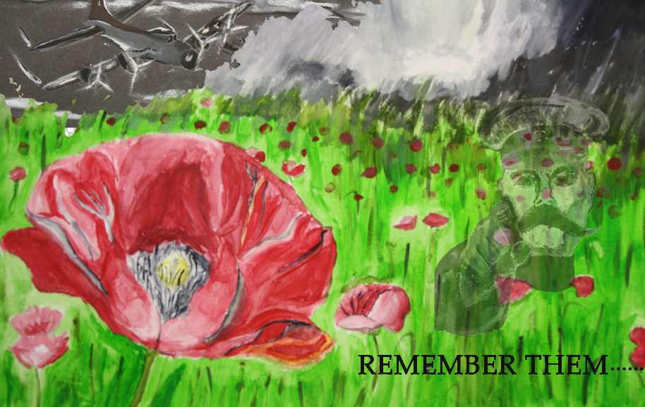

Slide 10
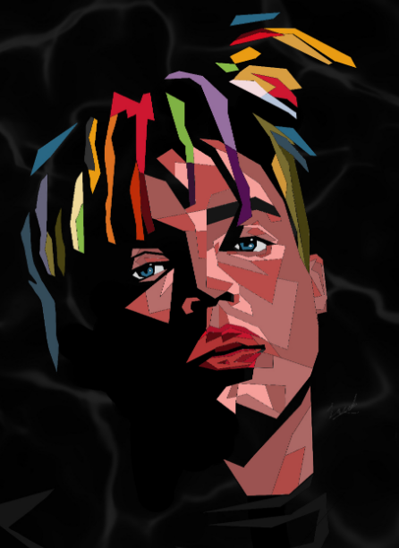
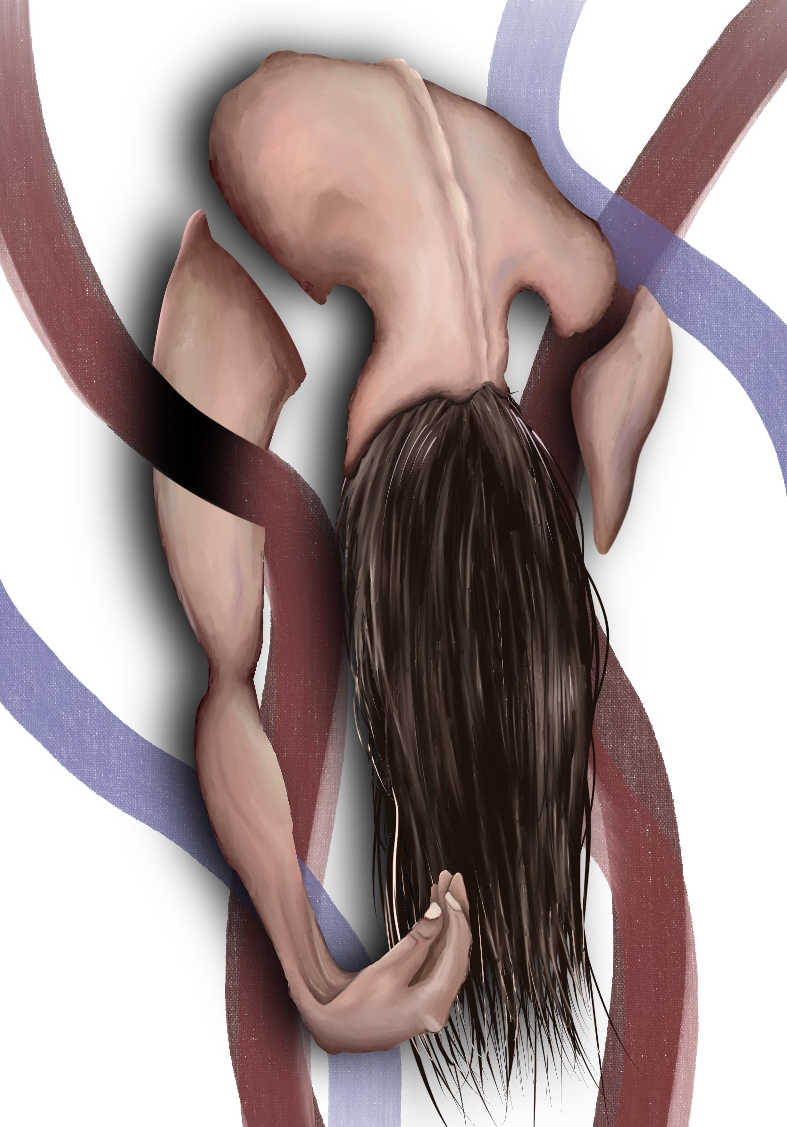

Slide 11
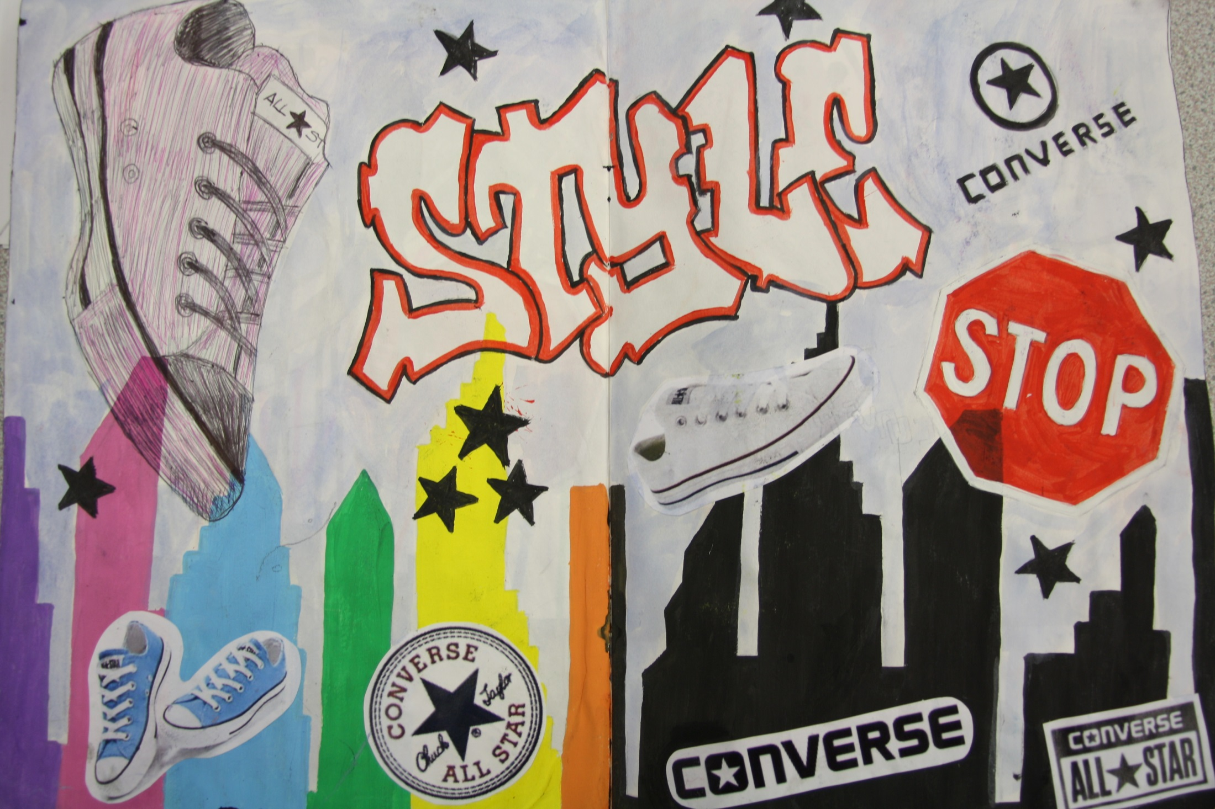
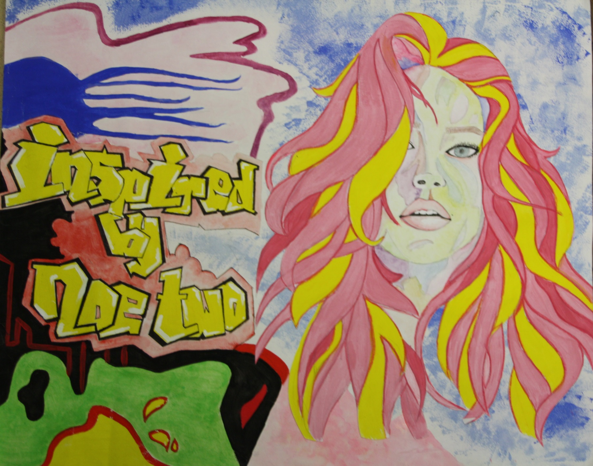
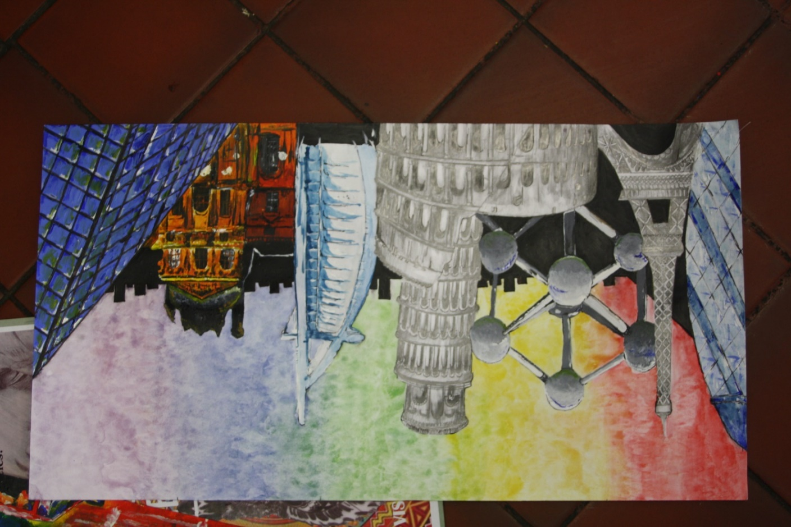
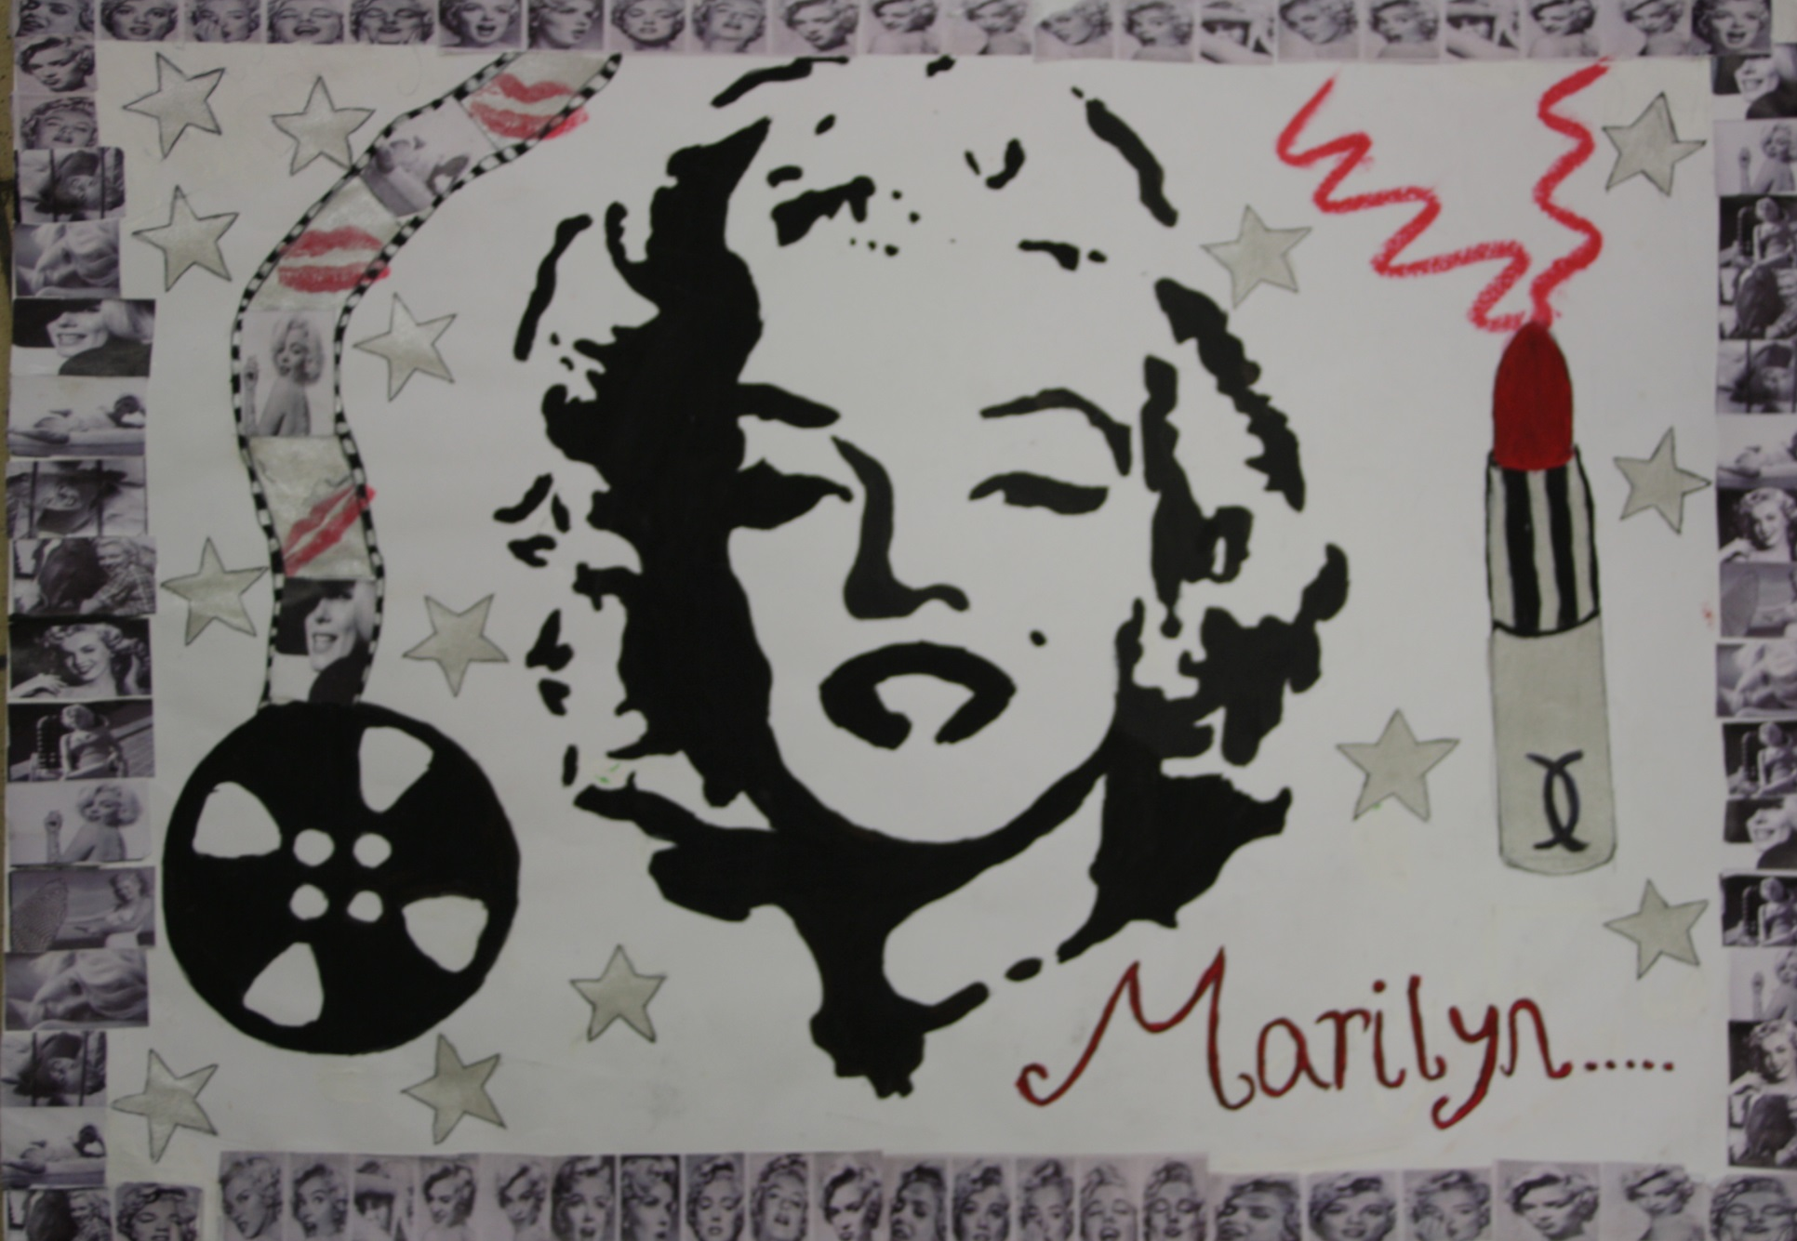

Slide 12
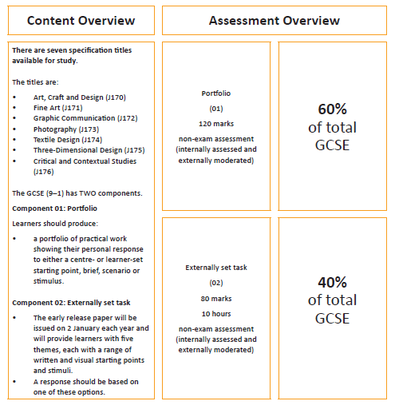
How will I
be assessed?
Notes:
Insert Video

Slide 13
Why should I pick GCSE Art & Design
Art has many transferable skills such as:
Creative problem-solving and decision-making.
Visual presentation skills and oral & written communication.
Self-motivation and the ability to work independently.
Organisation and planning skills.
Use of IT, particularly using creative software.
Notes:
Insert Video

Slide 14
What can Art &
Design lead to in the future?
Opportunities for Post 16 study:
Current progression into 6th Form would be A level Art and Design. This in turn leads to a Foundation course or direct entry onto a range of degree courses e.g. Graphics, Fine Art, Photography, 3D Design, Jewellery making, Theatre Studies, Sculpture, Animation, Illustration etc.
Career Prospects: Studying Art and Design can link to careers as a:
Fine Art painter or sculptor, Art historian, Mural painter, Exhibition coordinator/museum curator, Logo/Branding designer, Illustrator, Graphic designer, Interior or set/ theatre designer, Magazine designer, Advertising or fashion photographer, Web designer, Packaging designer, Special effects Artist/ Prop design, Jewellery maker, Landscape or Urban designer, Ceramic/Glass designer, Animator or filmmaker, Florist, Art therapist, Photojournalist.
Notes:
Insert Video

Slide 15
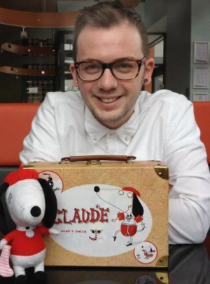
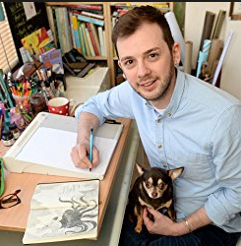
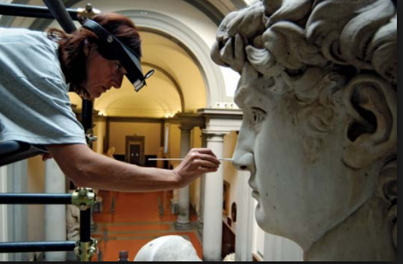
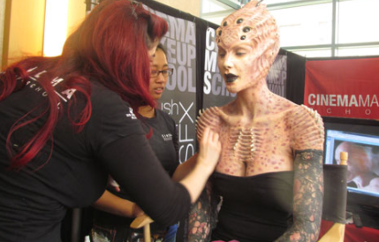
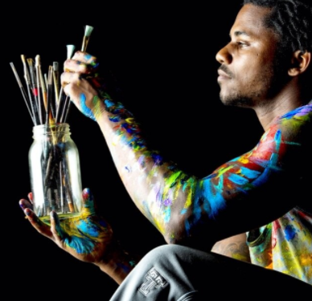
Artist based
Book
Illustrator
Art conservationist
Special effects
make-up artist
Painter

Slide 16
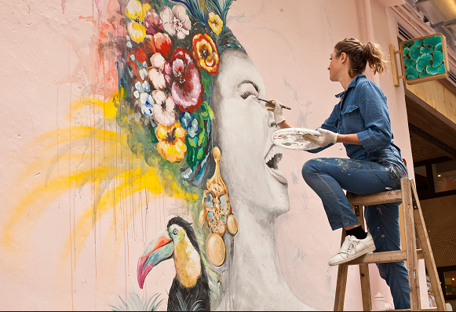
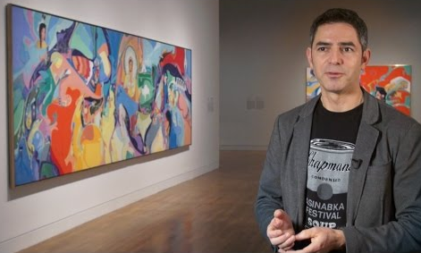
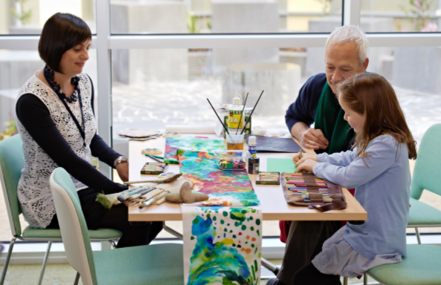
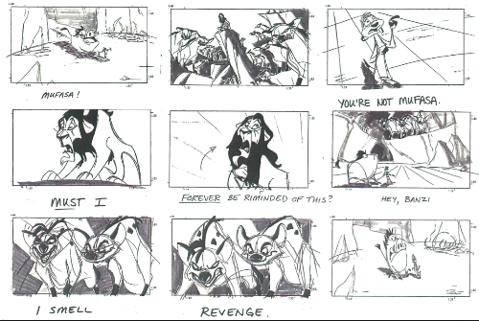
Artist
Mural
artist
Art curator
Art therapist
Story board Illustrator

Slide 17
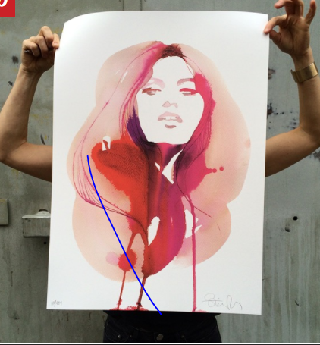
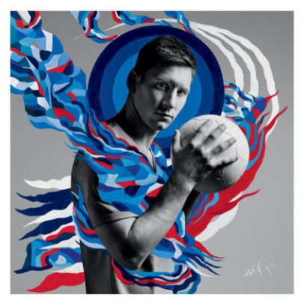
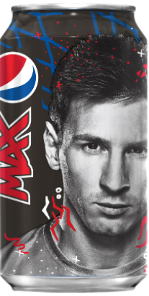
Graphic designer
Packaging
designer
Logo
brand
designer
Advert designer
Magazine designer

Slide 18
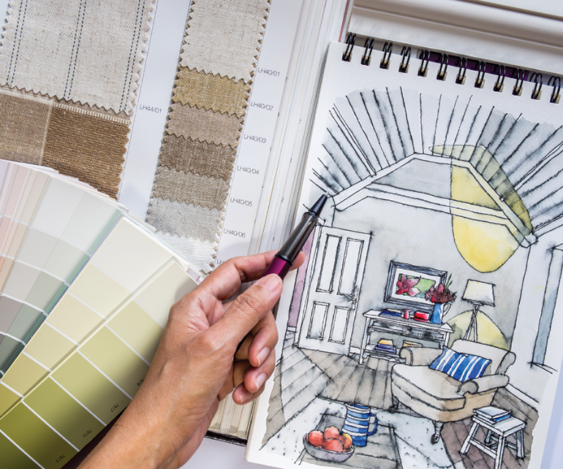
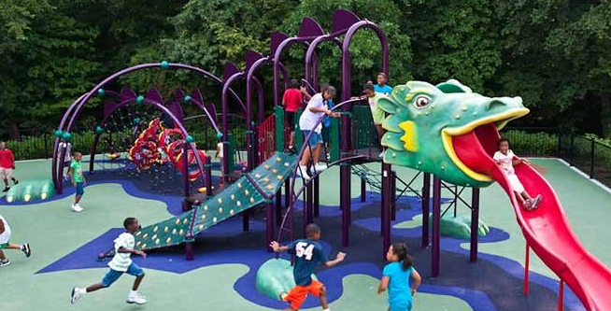
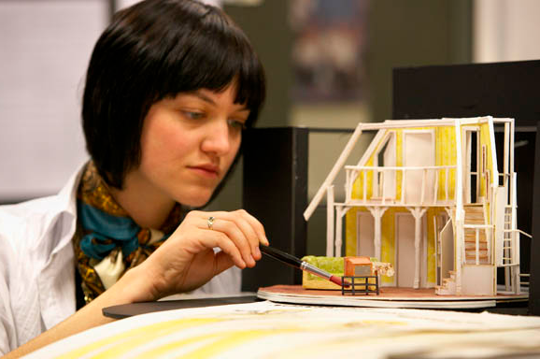
Spatial designer
Interior
designer
Architect
Urban space designer
Set designer

Slide 19
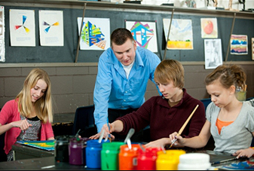
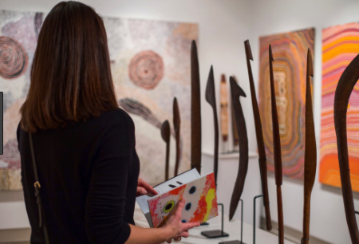
Art based
Photographer
Art teacher
Art dealer/buyer
Film maker

Slide 20
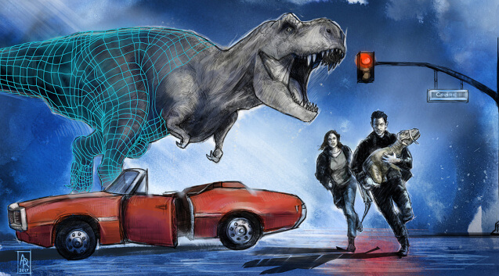
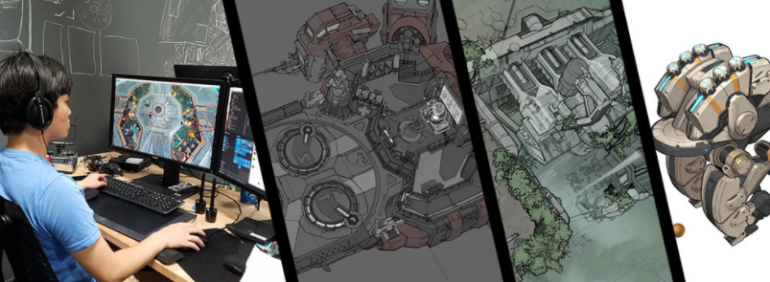
Digital/multi media
Video game designer
Special effects designer
Web designer

Slide 21
Where can I find any further information?
Speak to Mrs Wycherley or Mrs Moore in your Art lessons.
Notes:
Insert Video

