Slide 1
Welcome
PSHE Parent Consultation

Slide 4
Part Five: Child on Child Sexual Violence and Sexual Harassment
PSHE Parent Consultation
This part of the statutory guidance is about how we as schools should respond to all reports and concerns of child on child sexual violence and sexual harassment, including those that have happened outside of the school premises and/or online
Sexual violence and sexual harassment can occur between two children of any age and sex, from primary through to secondary stage and into colleges
It can occur through a group of children sexually assaulting or sexually harassing a single child or group of children

Slide 5
PSHE Parent Consultation
Sexual violence and sexual harassment exist on a continuum and may overlap
They can occur online and face to face (both physically and verbally) and are never acceptable
As set out in Part One of KCSIE, all staff working with children are advised to maintain an attitude of ‘it could happen here’

Slide 6
PSHE Parent Consultation
Addressing inappropriate behaviour (even if it appears to be relatively innocuous) can be an important intervention that helps prevent problematic, abusive and/or violent behaviour in the future
Children who are victims of sexual violence and sexual harassment wherever it happens, will likely find the experience stressful and distressing
This will, in all likelihood, adversely affect their educational attainment and will be exacerbated if the alleged perpetrator(s) attends the same school

Slide 7
PSHE Parent Consultation
Whilst any report of sexual violence or sexual harassment should be taken seriously, staff should be aware it is more likely that girls will be the victims of sexual violence and sexual harassment and more likely it will be perpetrated by boys
But it is essential that all victims are reassured that they are being taken seriously and that they will be supported and kept safe
A victim should never be given the impression that they are creating a problem by reporting sexual violence or sexual harassment - nor should a victim ever be made to feel ashamed for making a report

Slide 8
 | Autumn Term |  | Spring Term |  | Summer Term
 | Half term 1 | Half term 2 | Half term 1 | Half term 2 | Half term 1 | Half term 2
Year 7 |  |  |  |  | Friendships, families, romance, relationships, puberty, periods
Year 8 |  |  |  |  | LGBTQAI+, peer pressure, consent, pornography, sexting and image sharing inc up skirting, risk taking-alcohol and sexual behaviour, FGM
Year 9 | Substance abuse, smoking, county lines, knife crime, gangs and peer pressure | Behave to achieve, growth mindset, anxiety and stress, depression | Aspirations, employability and workplace skills, managing money and bank accounts |  | Abusive relationships, child sexual exploitation, stereotyping prejudice and discrimination, body image, STI, pregnancy and miscarriage, abortion and different types of contraception
Year 10 | Gender and trans identity, sexism equality and gender prejudice, relationships and role models, the world of online dating (inc meeting up and catfishing), forced and arranged marriages, parenting, harassment and stalking, revenge porn |  | Social media and self esteem, Screen time, managing time effectively, social anxiety, managing grief and bereavement, tattoos and piercing, binge drinking, money laundering |  | Fake news, anti-social behaviour, community cohesion, hate crime, why do people become extremists, overt and covert
Year 11 | Bullying and body shaming, relationship break ups, types of relationships, harassment/ consent, what is good sex, safe sex and chem sex, what is sexual health, being same on holiday |  | Revision strategies, applying for colleges, sleep, perseverance and procrastination, managing stress and anxiety, motivation |  | Money management, Tax and NI, money personality, gambling | Study leave

Slide 9
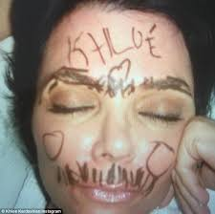
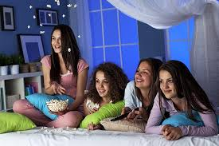
What is consent and why is it so important we learn about it?
Hannah went to a friend’s sleep-over. After staying up late and having fun, she fell asleep first. As Hannah slept, her friends decided to draw on her face with marker pens.
The next day Hannah was furious. Not only could she not get the pen off but she felt horrible and weird about her friends doing things to her while she was asleep.
Why did this make Hannah feel so horrible?
Would she have felt different if she couldn’t get the pen off but had allowed them to draw on her?
Explain the meaning of the word ‘consent’.

Slide 10
What is consent and why is it so important we learn about it?
Key Terms
Consent – to give permission for something to happen.
Non-consensual – doing something without someone’s permission.
Non-consensual sex – this means rape.
Key Words
Learning Outcomes:
Correctly identify cases where consent has or has not been given.
Describe the ‘cup of tea’ analogy and how it can be used to explain consent accurately.
Explain whether consent has been given in particular situations and how you know this.

Slide 11
Task One:
https://www.youtube.com/watch?v=u7Nii5w2FaI
Watch the clip carefully and then complete the table:
What is the clip trying to say?
Is this point easy to understand?
Are there ever any cases where you should make an unconscious person drink tea, or a conscious person drink it against their will? What could potentially happen if you did?
We’re now going to look at some serious real life instances where people need to be very aware of the concept of consent.
Times people will drink tea. | Times people won’t drink tea.

Slide 12
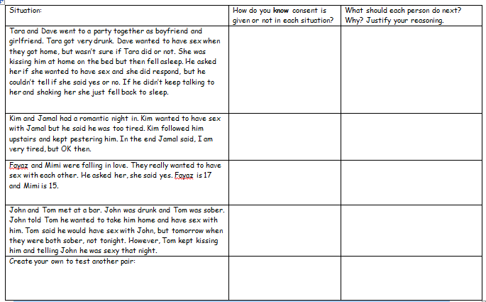
Task Two:
Your teacher will now give you a real life
situations sheet according to your challenge level.
Discuss the situations carefully with your partner and be prepared to feedback to the class with your ideas.

Slide 13
Plenary – Exactly Ten
Summarise in EXACTLY 10 words what the most important thing is about consent that everyone should know……
Learning Outcomes:
Correctly identify cases where consent has or has not been given.
Describe the ‘cup of tea’ analogy and how it can be used to explain consent accurately.
Explain whether consent has been given in particular situations and how you know this.

